Slide 1
Lecture #8: Decision Trees and Random Forests

Slide 2
ANNOUNCEMENTS
HW2 grades will be released tonight.
HW3 is due tonight at 11:59pm
Please see the Ed Announcement regarding errata and clarifications.
HW Submission (in general): please (1) don't submit zip files (2) rerun you notebook (3) and make sure your answers are prominent (i.e., not hidden in a comment)
HW4 is posted. Back to a Tues due date (7/21).

Slide 3
Outline
Motivation
Decision Trees
Classification Trees
Splitting Criteria
Stopping Conditions & Pruning
Regression Trees
Ensemble Methods:
Bootstrap-Aggregating (Bagging) Trees
Random Forests

Slide 4
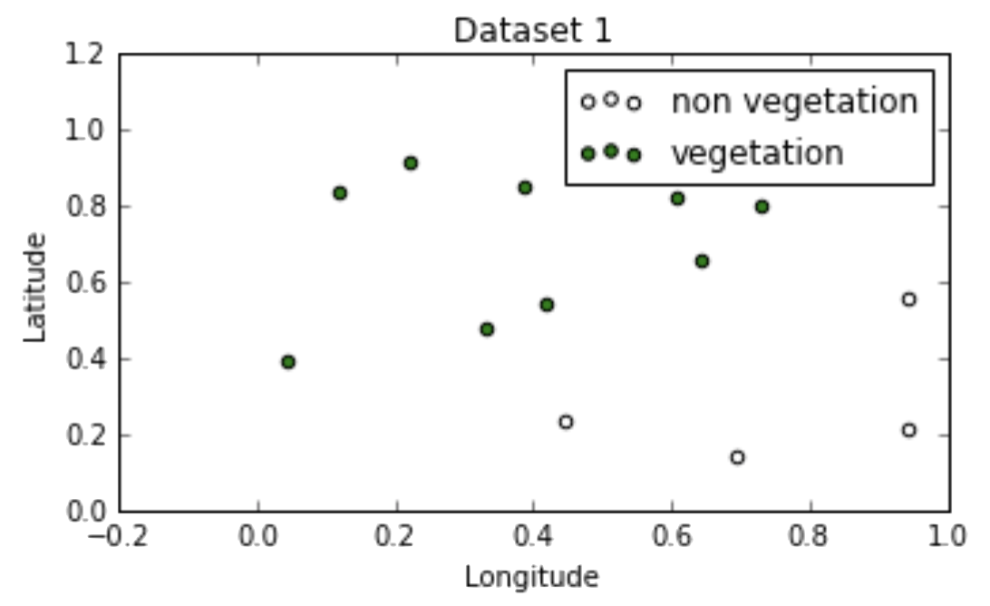
Geometry of Data
Recall:
logistic regression for building classification boundaries works best when:
the classes are well-separated in the feature space
have a nice geometry to the classification boundary)

Slide 5
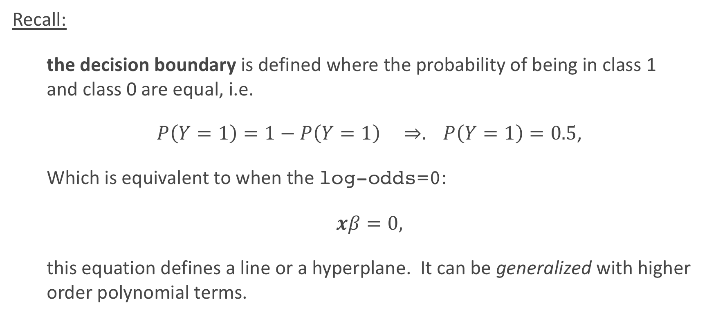
Geometry of Data
Recall:
the decision boundary is defined where the probability of being in class 1 and class 0 are equal, i.e.
$P\left(Y=1\right)=1−P\left(Y=1\right) ⇒. P\left(Y=1\right)=0.5$,
Which is equivalent to when the log-odds=0:
$xβ=0,$
this equation defines a line or a hyperplane. It can be generalized with higher order polynomial terms.

Slide 6
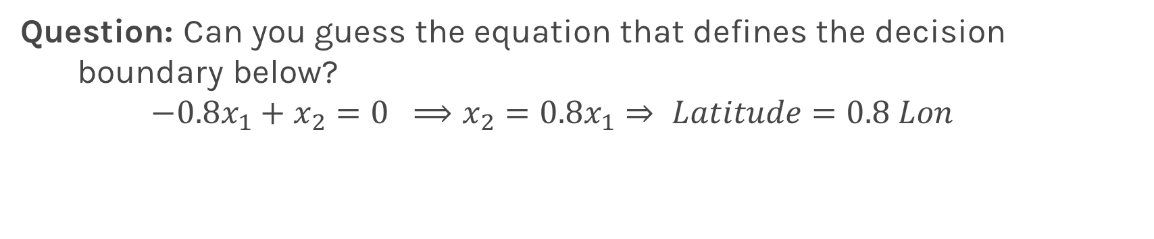
Geometry of Data
Question: Can you guess the equation that defines the decision boundary below?
$$−0.8x_{1}+x_{2}=0 ⟹x_{2}=0.8x_{1}⇒ Latitude=0.8 Lon$$

Slide 7
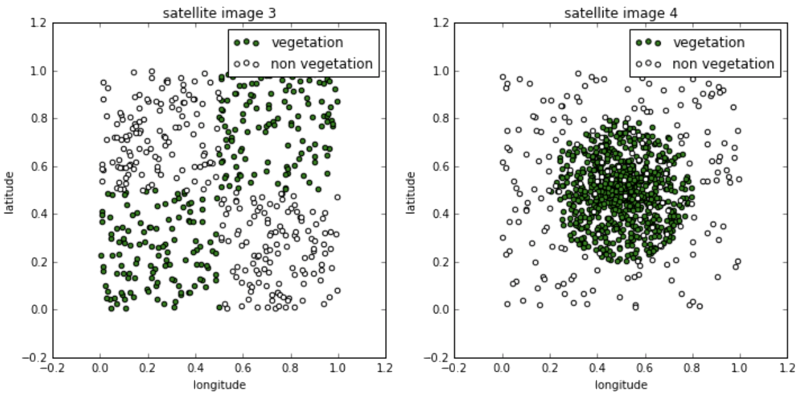
Geometry of Data
Question: How about these?

Slide 8
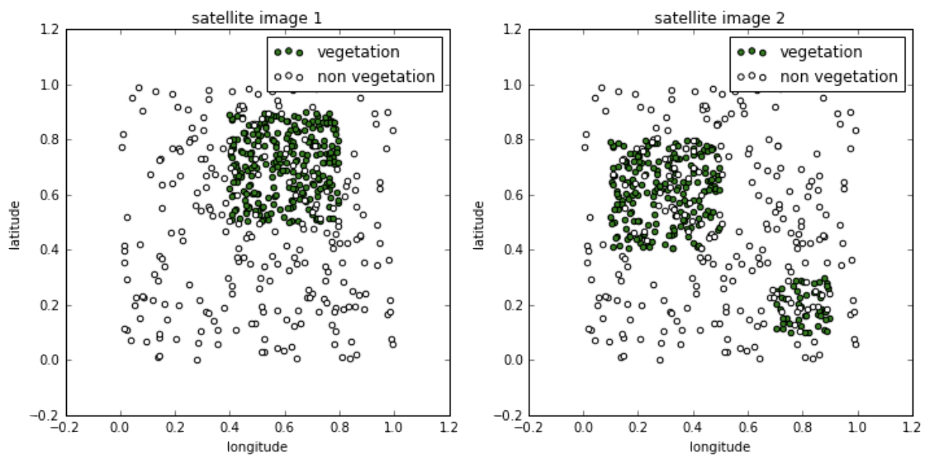
Geometry of Data
Question: Or these?

Slide 9
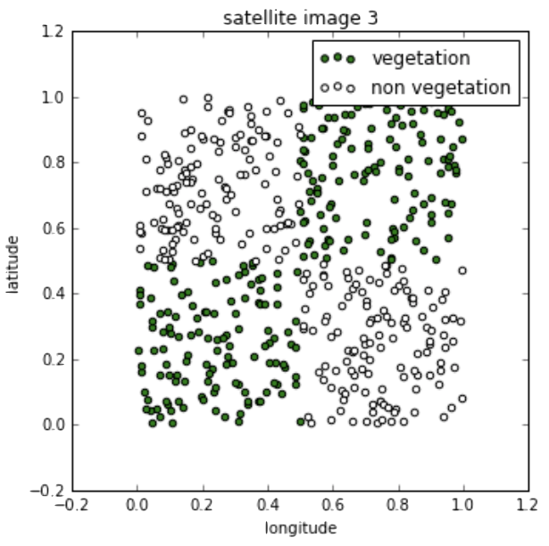
Geometry of Data
Notice that in all of the datasets the classes are still well-separated in the feature space, but the decision boundaries cannot easily be described by single equations:

Slide 10
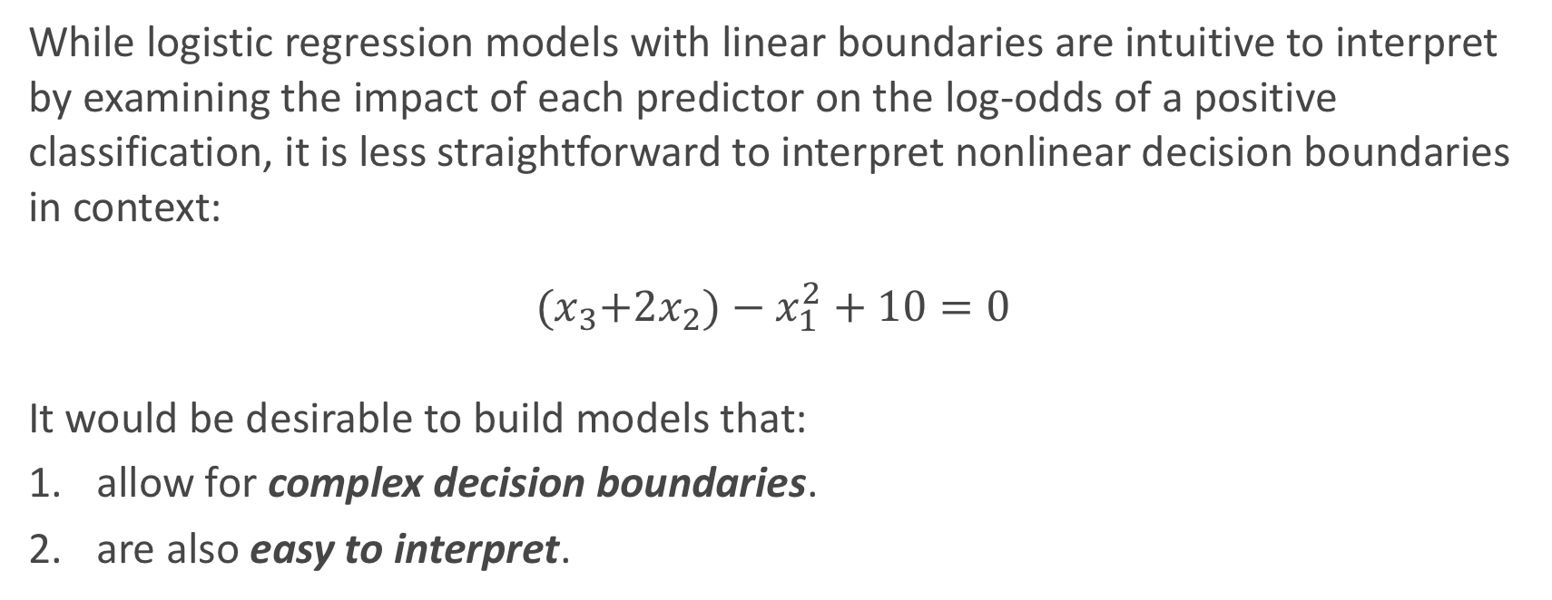
Geometry of Data
While logistic regression models with linear boundaries are intuitive to interpret by examining the impact of each predictor on the log-odds of a positive classification, it is less straightforward to interpret nonlinear decision boundaries in context:
$${(x}_{3}+2x_{2})−x_{1}^{2}+10=0$$
It would be desirable to build models that:
allow for complex decision boundaries.
are also easy to interpret.

Slide 11

Interpretable Models
People in every walk of life have long been using interpretable models for differentiating between classes of objects and phenomena:

Slide 12
Interpretable Models (cont.)
Or in the [inferential] data analysis world:

Slide 13
Decision Trees
It turns out that the simple flow charts in our examples can be formulated as mathematical models for classification and these models have the properties we desire; they are:
interpretable by humans
have sufficiently complex decision boundaries
the decision boundaries are locally linear, each component of the decision boundary is simple to describe mathematically.

Slide 14
Decision Trees

Slide 15
The Geometry of Flow Charts
Flow charts whose graph is a tree (connected and no cycles) represents a model called a decision tree.
Formally, a decision tree model is one in which the final outcome of the model is based on a series of comparisons of the values of predictors against threshold values.
In a graphical representation (flow chart),
the internal nodes of the tree represent attribute testing.
branching in the next level is determined by attribute value (yes/no).
terminal leaf nodes represent class assignments.
Notes:
Change this to interactive

Slide 16
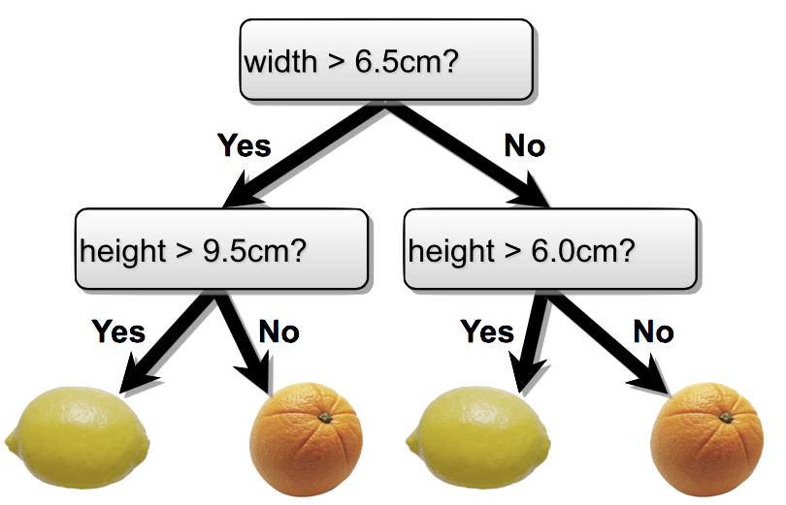
The Geometry of Flow Charts
Flow charts whose graph is a tree (connected and no cycles) represents a model called a decision tree.
Formally, a decision tree model is one in which the final outcome of the model is based on a series of comparisons of the values of predictors against threshold values.

Slide 17
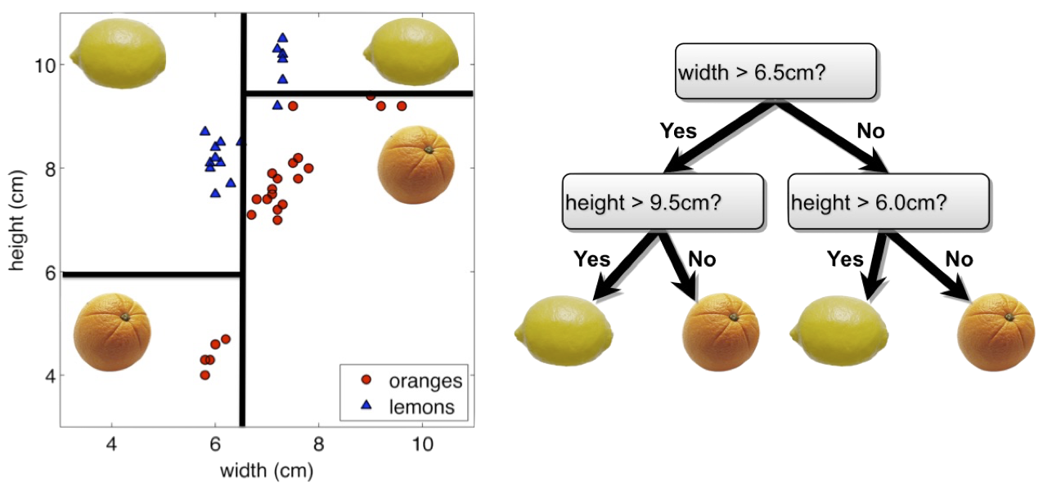
The Geometry of Flow Charts
Every flow chart tree corresponds to a partition of the feature space by axis aligned lines or (hyper) planes. Conversely, every such partition can be written as a flow chart tree.

Slide 18
The Geometry of Flow Charts
Each comparison and branching represents splitting a region in the feature space on a single feature. Typically, at each iteration, we split once along one dimension (one predictor). Why?

Slide 19
Learning the Model
Given a training set, learning a decision tree model for binary classification means:
producing an optimal partition of the feature space with axis-aligned linear boundaries (very interpretable!),
each region is predicted to have a class label based on the largest class of the training points in that region (Bayes’ classifier) when performing prediction.

Slide 20
Learning the Model
Learning the smallest ‘optimal’ decision tree for any given set of data is NP complete for numerous simple definitions of ‘optimal’. Instead, we will seek a reasonably model using a greedy algorithm.
Start with an empty decision tree (undivided feature space)
Choose the ‘optimal’ predictor on which to split and choose the ‘optimal’ threshold value for splitting.
Recurse on each new node until stopping condition is met
Now, we need only define our splitting criterion and stopping condition.

Slide 21
Numerical vs Categorical Attributes
Note that the ‘compare and branch’ method by which we defined classification tree works well for numerical features.
However, if a feature is categorical (with more than two possible values), comparisons like feature < threshold does not make sense.
How can we handle this?
A simple solution is to encode the values of a categorical feature using numbers and treat this feature like a numerical variable. This is indeed what some computational libraries (e.g. sklearn) do, however, this method has drawbacks.

Slide 22
Numerical vs Categorical Attributes
Example
Supposed the feature we want to split on is color, and the values are: Red, Blue and Yellow. If we encode the categories numerically as:
Red = 0, Blue = 1, Yellow = 2
Then the possible non-trivial splits on color are
{{Red}, {Blue, Yellow}} {{Red, Blue},{Yellow}}
But if we encode the categories numerically as:
Red = 2, Blue = 0, Yellow = 1
The possible splits are
{{Blue}, {Yellow, Red}} {{Blue,Yellow}, {Red}}
Depending on the encoding, the splits we can optimize over can be different!

Slide 23
Numerical vs Categorical Attributes
In practice, the effect of our choice of naive encoding of categorical variables are often negligible - models resulting from different choices of encoding will perform comparably.
In cases where you might worry about encoding, there is a more sophisticated way to numerically encode the values of categorical variables so that one can optimize over all possible partitions of the values of the variable.
This more principled encoding scheme is computationally more expensive but is implemented in a number of computational libraries (e.g. R’s randomForest).

Slide 24
Splitting Criteria

Slide 25
Optimality of Splitting
While there is no ‘correct’ way to define an optimal split, there are some common sensical guidelines for every splitting criterion:
the regions in the feature space should grow progressively more pure with the number of splits. That is, we should see each region ‘specialize’ towards a single class.
the fitness metric of a split should take a differentiable form (making optimization possible).
we shouldn’t end up with empty regions - regions containing no training points.

Slide 26
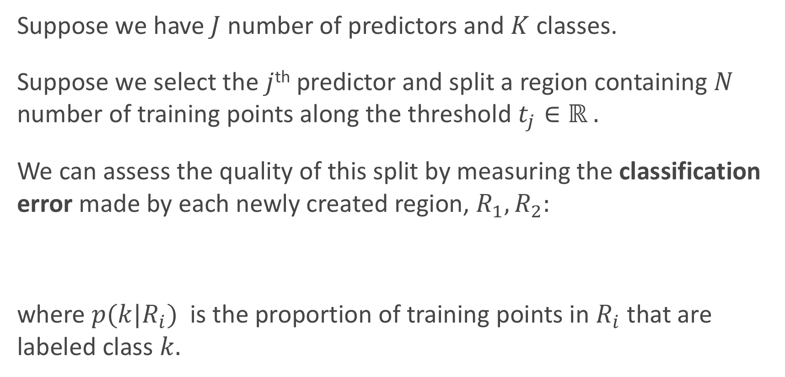
Classification Error
Suppose we have $J$ number of predictors and $K$ classes.
Suppose we select the $j$^{th} predictor and split a region containing $N$ number of training points along the threshold $t_{j}∈ℝ .$
We can assess the quality of this split by measuring the classification error made by each newly created region, $R_{1},R_{2}:$
where $p(k|R_{i})$ is the proportion of training points in $R_{i}$ that are labeled class $k.$

Slide 27
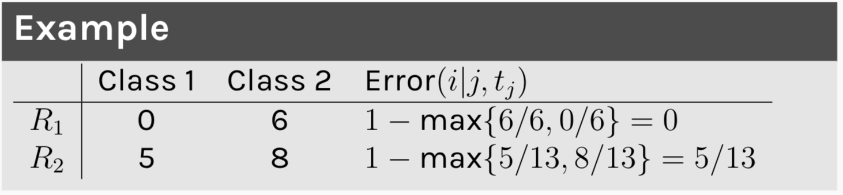
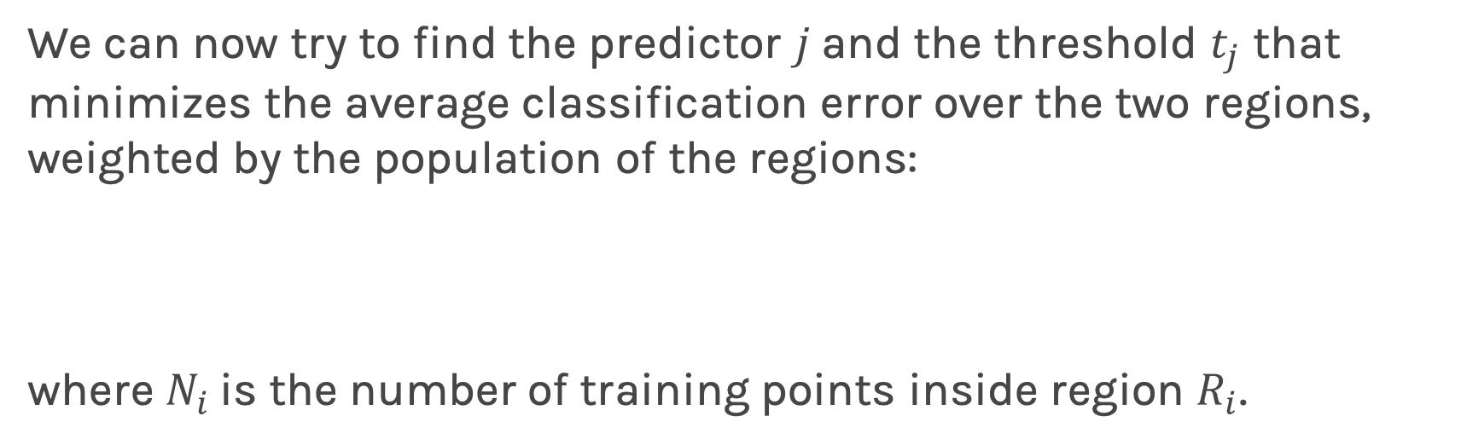
Classification Error
We can now try to find the predictor $j$and the threshold $t_{j}$ that minimizes the average classification error over the two regions, weighted by the population of the regions:
where $N_{i}$is the number of training points inside region $R_{i}$.

Slide 28
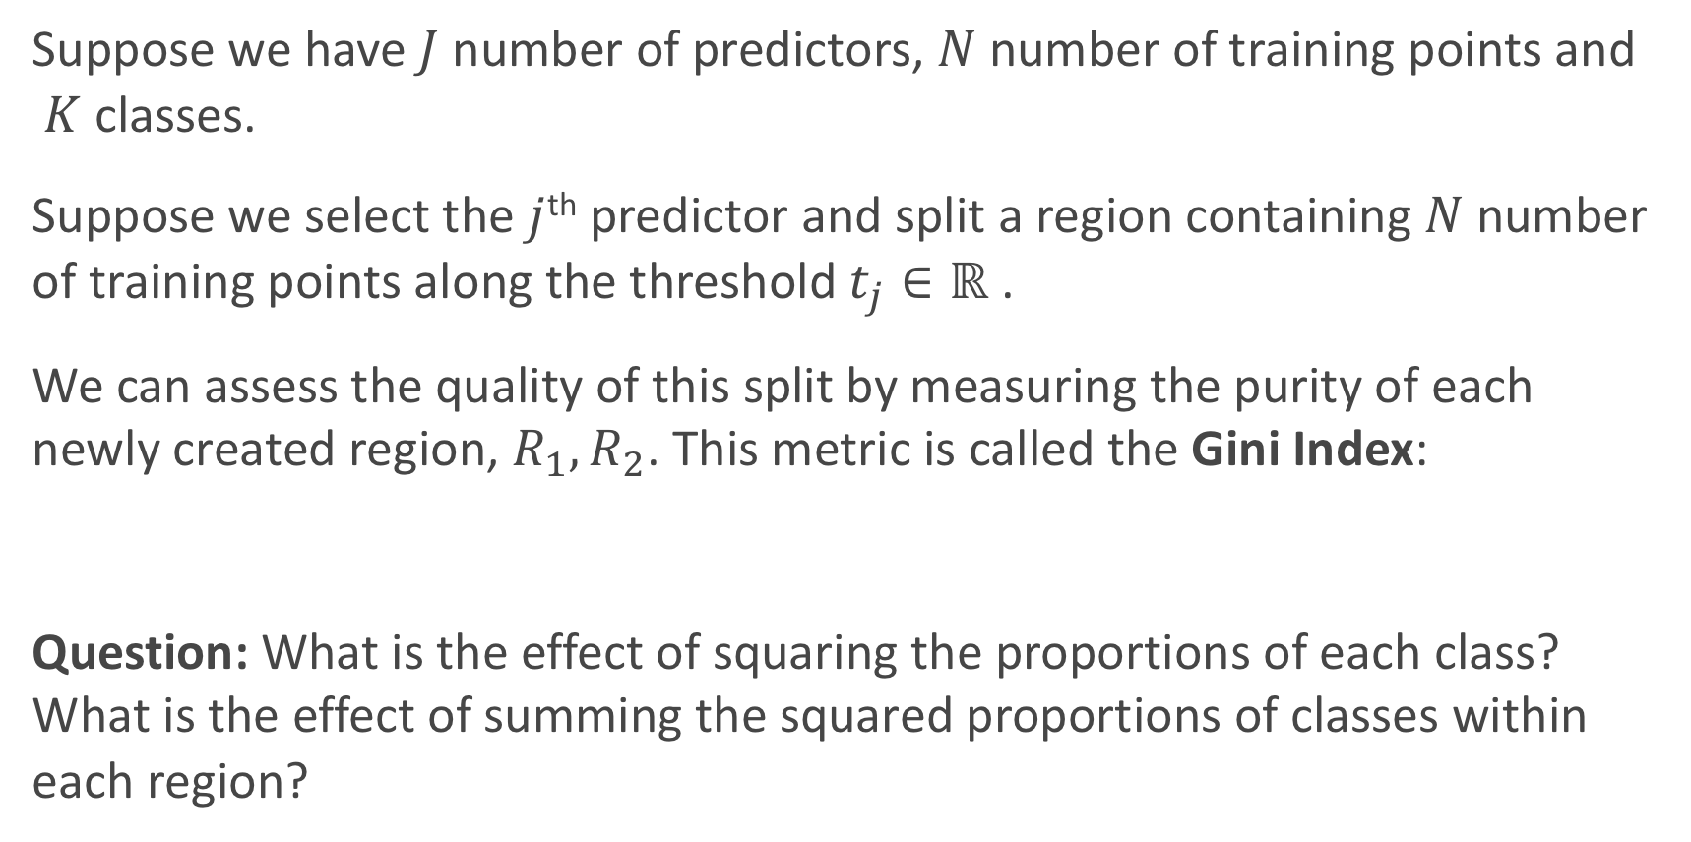
Gini Index
Suppose we have $J$ number of predictors, $N$ number of training points and $K$classes.
Suppose we select the $j$^{th} predictor and split a region containing $N$ number of training points along the threshold $t_{j}∈ℝ$.
We can assess the quality of this split by measuring the purity of each newly created region, $R_{1},R_{2}$. This metric is called the Gini Index:
Question: What is the effect of squaring the proportions of each class? What is the effect of summing the squared proportions of classes within each region?

Slide 29
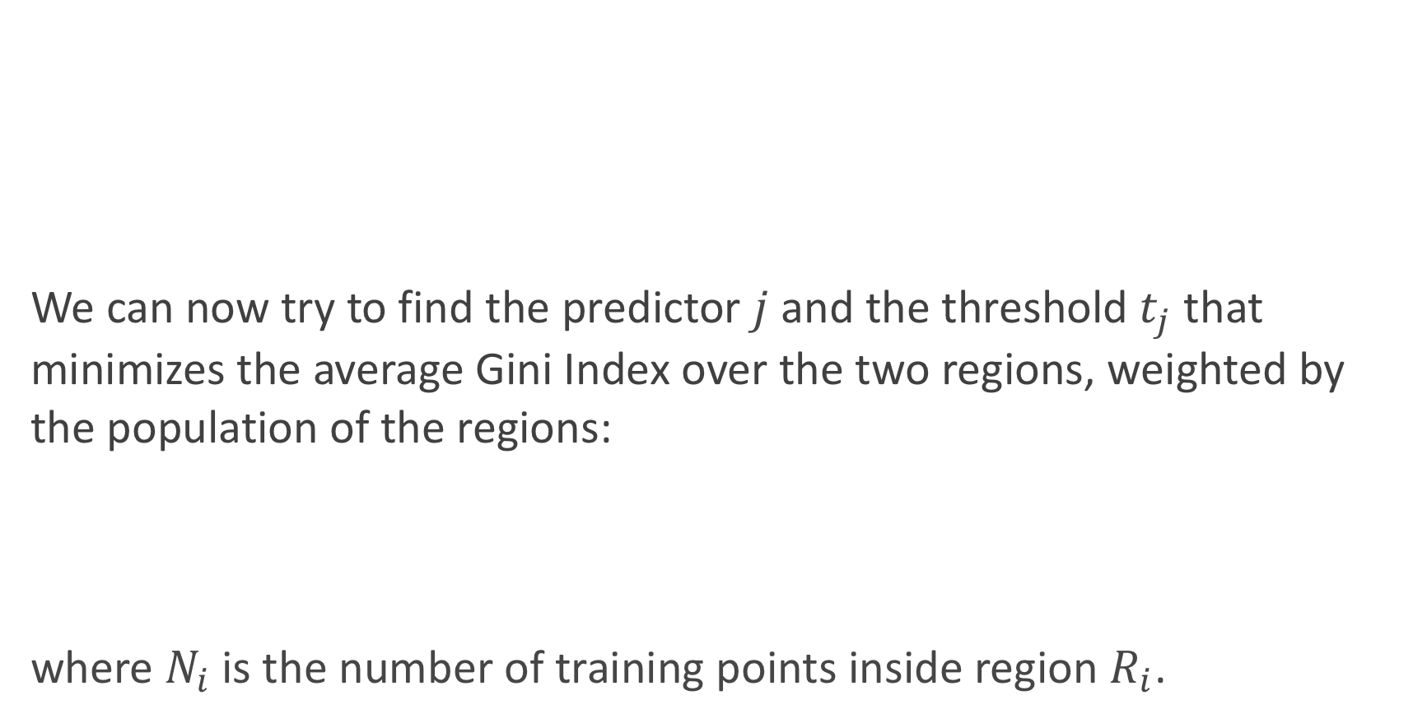
Gini Index
We can now try to find the predictor $j$ and the threshold $t_{j}$ that minimizes the average Gini Index over the two regions, weighted by the population of the regions:
where $N_{i}$is the number of training points inside region $R_{i}$.
Example

Slide 30
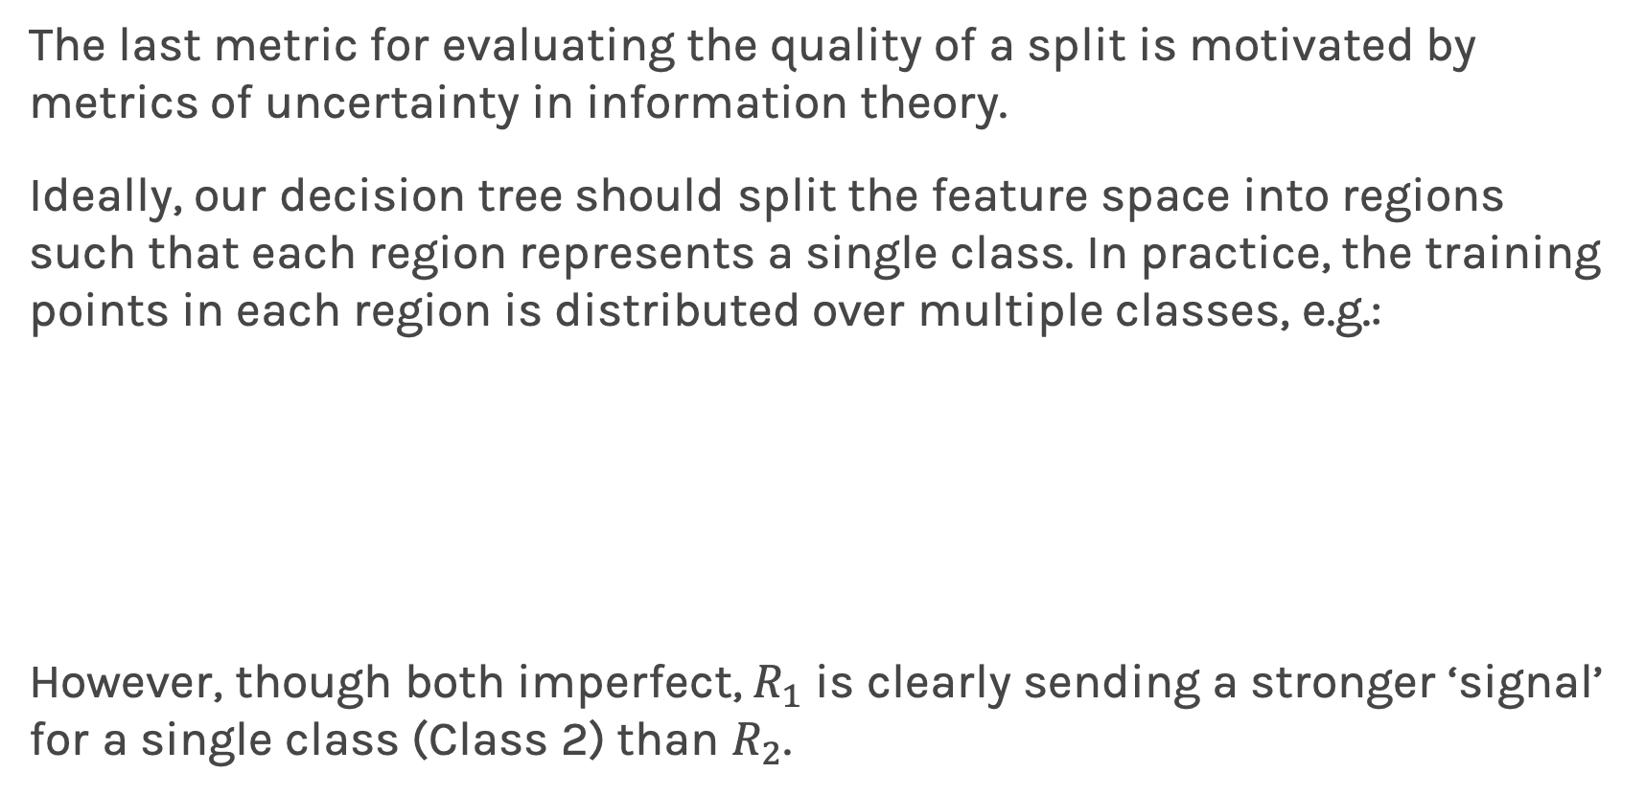
Information Theory
The last metric for evaluating the quality of a split is motivated by metrics of uncertainty in information theory.
Ideally, our decision tree should split the feature space into regions such that each region represents a single class. In practice, the training points in each region is distributed over multiple classes, e.g.:
However, though both imperfect, $R_{1}$ is clearly sending a stronger ‘signal’ for a single class (Class 2) than $R_{2}$.

Slide 31
Information Theory
One way to quantify the strength of a signal in a particular region is to analyze the distribution of classes within the region. We compute the entropy of this distribution.
For a random variable with a discrete distribution, the entropy is computed by:
Higher entropy means the distribution is uniform-like (flat histogram) and thus values sampled from it are ‘less predictable’ (all possible values are equally probable).
Lower entropy means the distribution has more defined peaks and valleys and thus values sampled from it are ‘more predictable’ (values around the peaks are more probable).

Slide 32
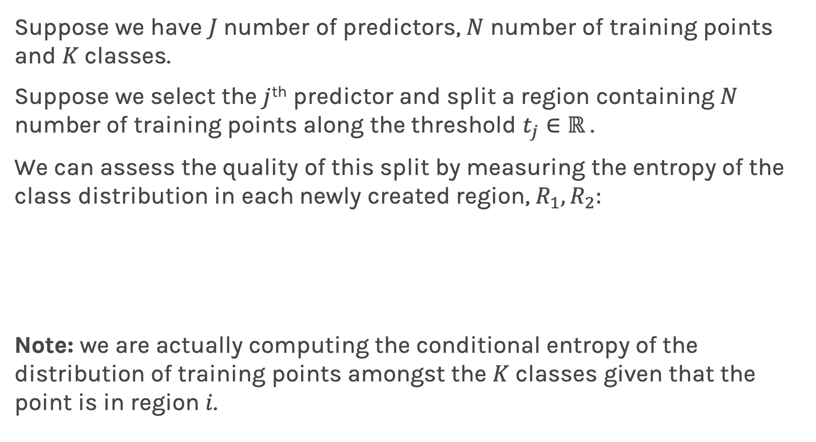
Entropy
Suppose we have $J$ number of predictors, $N$ number of training points and $K$classes.
Suppose we select the $j$^{th} predictor and split a region containing $N$ number of training points along the threshold $t_{j}∈ℝ$.
We can assess the quality of this split by measuring the entropy of the class distribution in each newly created region, $R_{1},R_{2}:$
Note: we are actually computing the conditional entropy of the distribution of training points amongst the $K$ classes given that the point is in region $i$.

Slide 33
Entropy
Example
We can now try to find the predictor j and the threshold t_{j} that minimizes the average entropy over the two regions, weighted by the population of the regions:

Slide 34
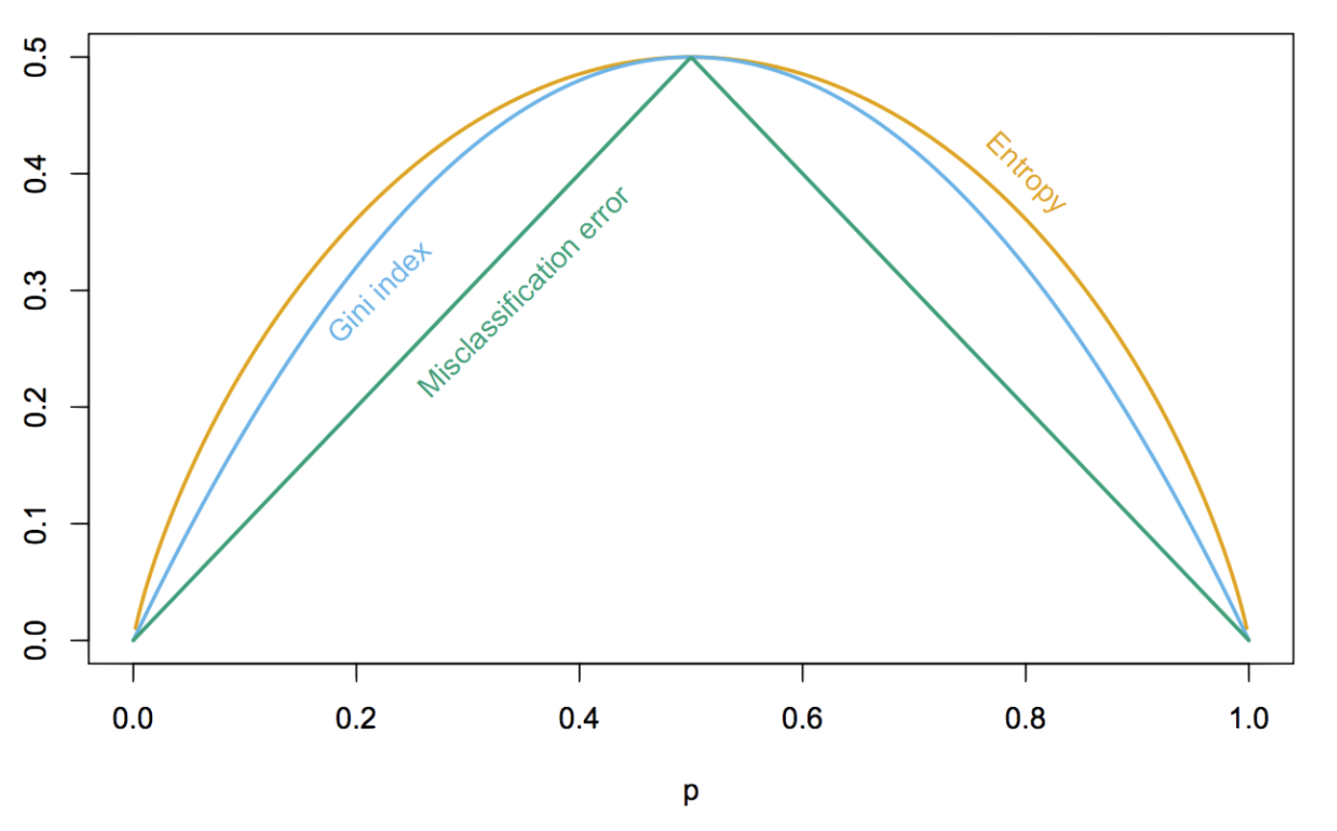
Comparison of Criteria
Recall our intuitive guidelines for splitting criteria, which of the three criteria fits our guideline the best?
We have the following comparison of the value of the three criteria at different levels of purity (from 0 to 1) in a single region (for binary outcomes).

Slide 35
Comparison of Criteria
Recall our intuitive guidelines for splitting criteria, which of the three criteria fits our guideline the best?
To note that entropy penalizes impurity the most is not to say that it is the best splitting criteria. For one, a model with purer leaf nodes on a training set may not perform better on the testing test.
Another factor to consider is the size of the tree (i.e. model complexity) each criteria tends to promote.
To compare different decision tree models, we need to first discuss stopping conditions.

Slide 36
Stopping Conditions & Pruning

Slide 37
Variance vs Bias
If we don’t terminate the decision tree learning algorithm manually, the tree will continue to grow until each region defined by the model possibly contains exactly one training point (and the model attains 100% training accuracy).
To prevent this from happening, we can simply stop the algorithm at a particular depth.
But how do we determine the appropriate depth?

Slide 38
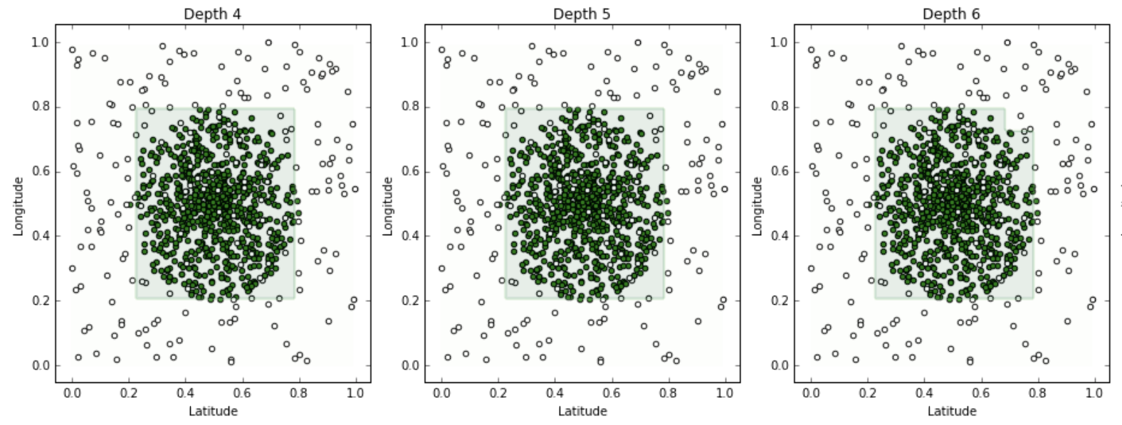
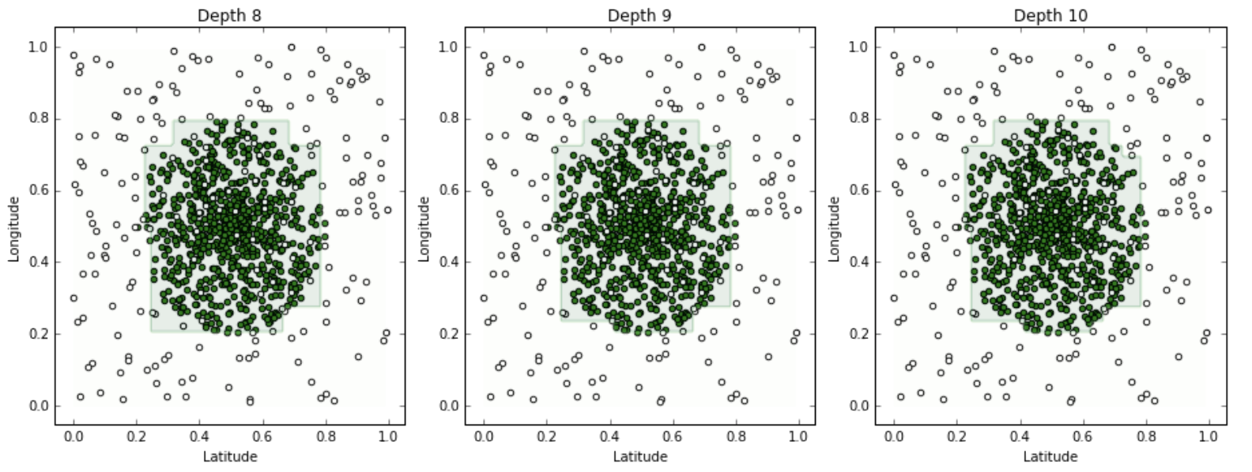
Variance vs Bias

Slide 39
Variance vs Bias
We make some observations about our models:
(High Bias) A tree of depth 4 is not a good fit for the training data - it’s unable to capture the nonlinear boundary separating the two classes.
(Low Bias) With an extremely high depth, we can obtain a model that correctly classifies all points on the boundary (by zig-zagging around each point).
(Low Variance) The tree of depth 4 is robust to slight perturbations in the training data - the square carved out by the model is stable if you move the boundary points a bit.
(High Variance) Trees of high depth are sensitive to perturbations in the training data, especially to changes in the boundary points.
Not surprisingly, complex trees have low bias (able to capture more complex geometry in the data) but high variance (can overfit). Complex trees are also harder to interpret and more computationally expensive to train.

Slide 40
Stopping Conditions
Common simple stopping conditions:
Don’t split a region if all instances in the region belong to the same class.
Don’t split a region if the number of instances in the sub-region will fall below pre-defined threshold (min_samples_leaf).
Don’t split a region if the total number of leaves in the tree will exceed pre-defined threshold.
The appropriate thresholds can be determined by evaluating the model on a held-out data set or, better yet, via cross-validation.

Slide 41
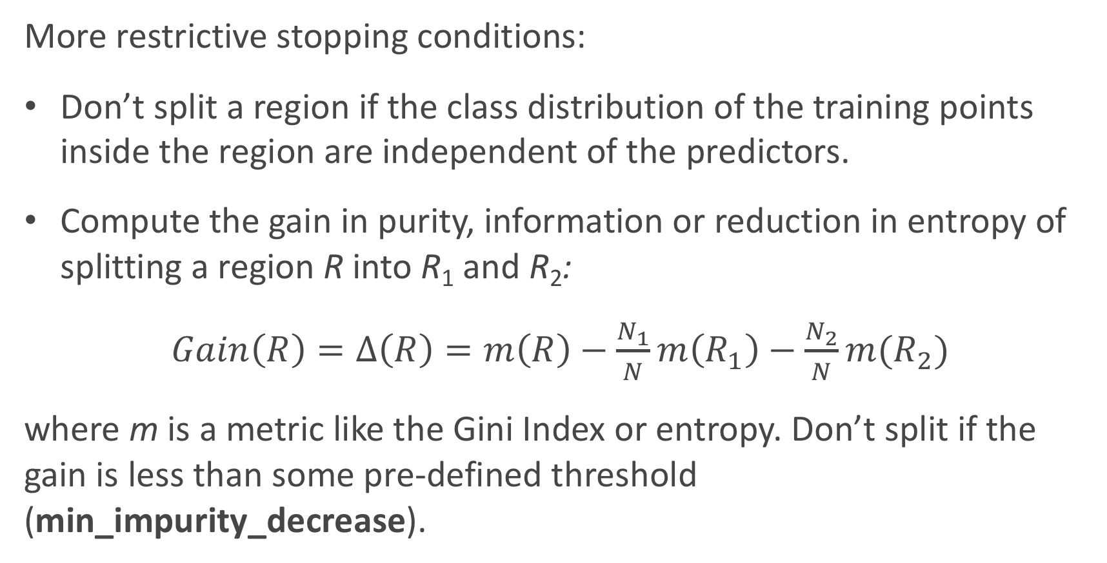
Stopping Conditions
More restrictive stopping conditions:
Don’t split a region if the class distribution of the training points inside the region are independent of the predictors.
Compute the gain in purity, information or reduction in entropy of splitting a region R into R₁ and R₂:
$Gain\left(R\right)=Δ\left(R\right)=m\left(R\right)−\frac{N_{1}}{N}m\left(R_{1}\right)−\frac{N_{2}}{N}m(R_{2})$
where m is a metric like the Gini Index or entropy. Don’t split if the gain is less than some pre-defined threshold (min_impurity_decrease).

Slide 42
Alternative to Using Stopping Conditions
What is the major issue with pre-specifying a stopping condition?
you may stop too early or stop too late.
How can we fix this issue?
choose several stopping criterion (set minimal Gain(R) at various levels) and cross-validate which is the best.
What is an alternative approach to this issue?
Don’t stop. Instead prune back!

Slide 43
To Hot Dog or Not Hot Dog…

Slide 44
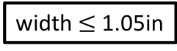
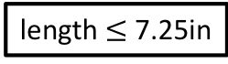
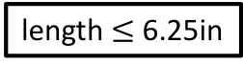
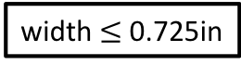
Hot Dog or Not
width $≤$ 1.05in
yes
no
width $≤$ 0.725in
yes
no
length $≤$ 6.25in
length $≤$ 7.25in
yes
no
yes
no

Slide 45
Motivation for Pruning

Slide 46
Motivation for Pruning

Slide 47
Motivation for Pruning

Slide 48
Motivation for Pruning

Slide 49
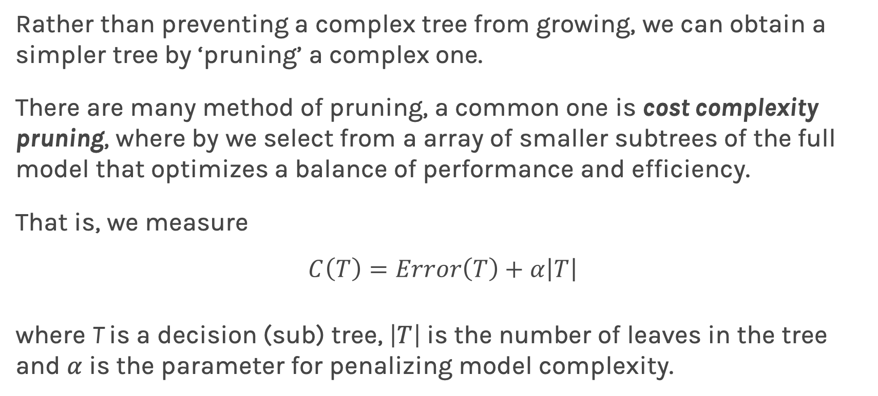
Pruning
Rather than preventing a complex tree from growing, we can obtain a simpler tree by ‘pruning’ a complex one.
There are many method of pruning, a common one is cost complexity pruning, where by we select from a array of smaller subtrees of the full model that optimizes a balance of performance and efficiency.
That is, we measure
$$C\left(T\right)=Error\left(T\right)+α\left|T\right|$$
where T is a decision (sub) tree, $\left|T\right|$ is the number of leaves in the tree and $α$ is the parameter for penalizing model complexity.

Slide 50
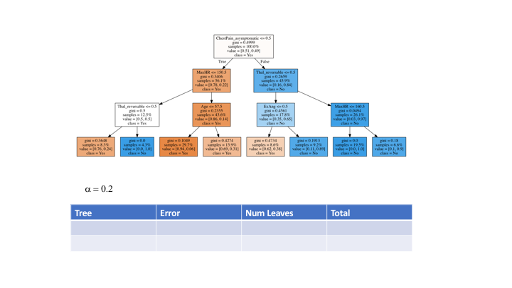
Pruning

Slide 51
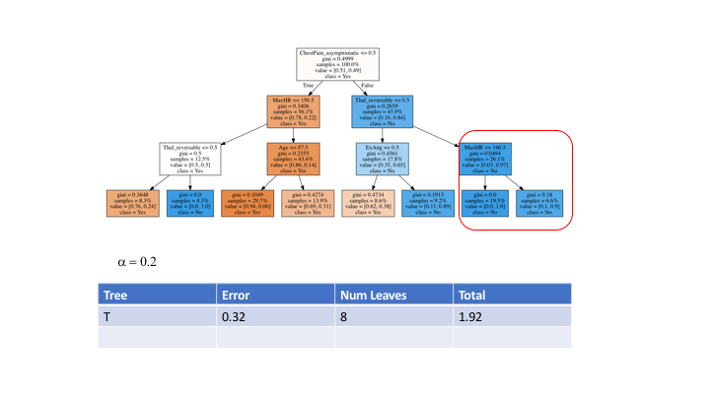
Pruning

Slide 52
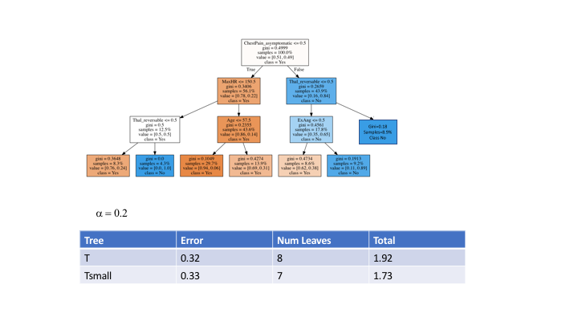
Pruning

Slide 53
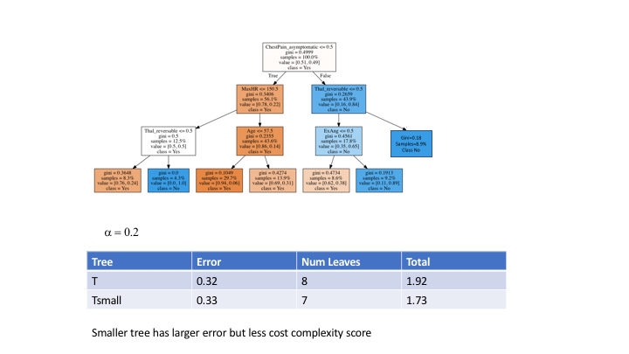
Pruning

Slide 54
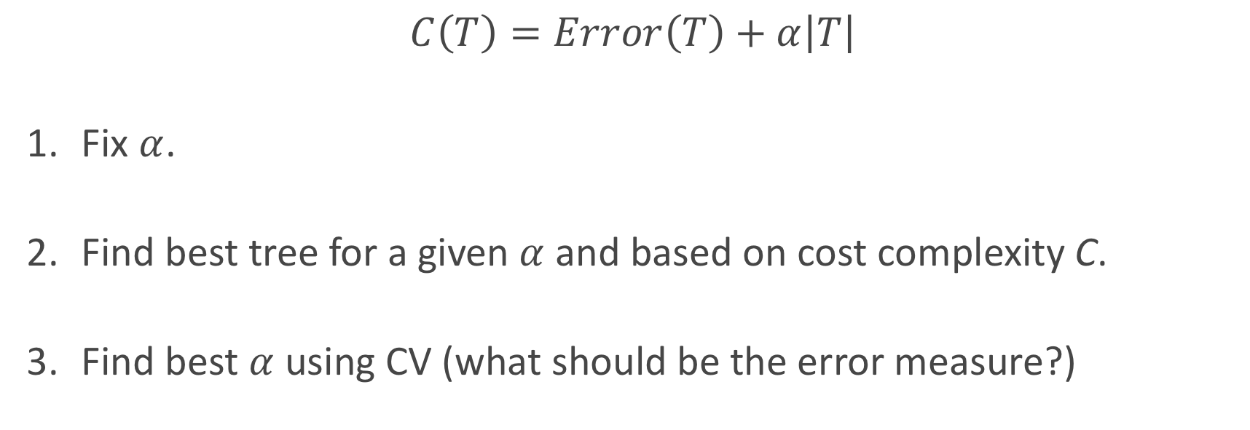
Pruning
$$C\left(T\right)=Error\left(T\right)+α\left|T\right|$$
Fix $α$.
Find best tree for a given $α$ and based on cost complexity C.
Find best $α$ using CV (what should be the error measure?)

Slide 55
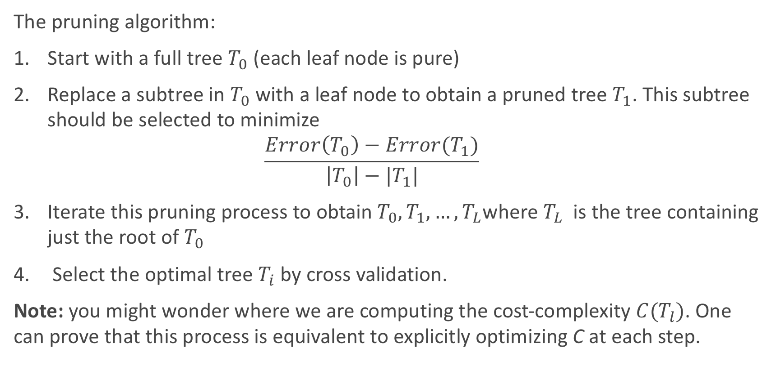
Pruning
The pruning algorithm:
Start with a full tree $T_{0}$ (each leaf node is pure)
Replace a subtree in $T_{0}$ with a leaf node to obtain a pruned tree $T_{1}$. This subtree should be selected to minimize $\frac{Error\left(T_{0}\right)−Error(T_{1})}{\left|T_{0}\right|−|T_{1}|}$
Iterate this pruning process to obtain $T_{0},T_{1},…,T_{L}$where $T_{L}$ is the tree containing just the root of $T_{0}$
Select the optimal tree $T_{i}$by cross validation.
Note: you might wonder where we are computing the cost-complexity $C(T_{l})$. One can prove that this process is equivalent to explicitly optimizing C at each step.

Slide 56
Next
How can this decision tree approach apply to a regression problem (quantitative outcome)?
Questions to consider:
What would be a reasonable loss function?
How would you determine any splitting criteria?
How would you perform prediction in each leaf?
A picture is worth a thousand words…

Slide 57
Regression Tree Example
How do we decide a split here?

Slide 58
Decision Trees for Regression

Slide 59
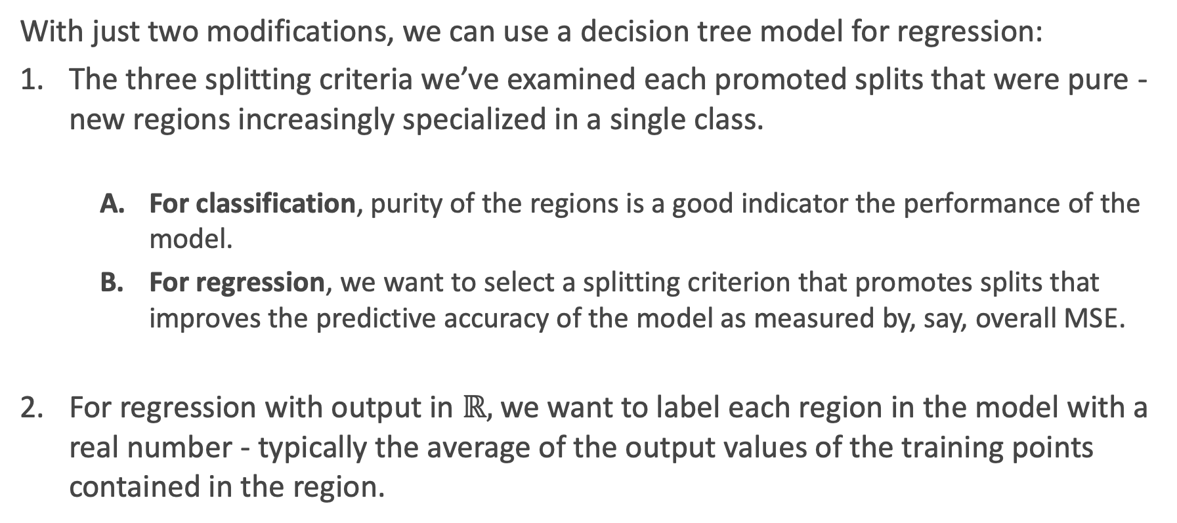
Adaptations for Regression
With just two modifications, we can use a decision tree model for regression:
The three splitting criteria we’ve examined each promoted splits that were pure - new regions increasingly specialized in a single class.
For classification, purity of the regions is a good indicator the performance of the model.
For regression, we want to select a splitting criterion that promotes splits that improves the predictive accuracy of the model as measured by, say, overall MSE.
For regression with output in $ℝ,$ we want to label each region in the model with a real number - typically the average of the output values of the training points contained in the region.

Slide 60
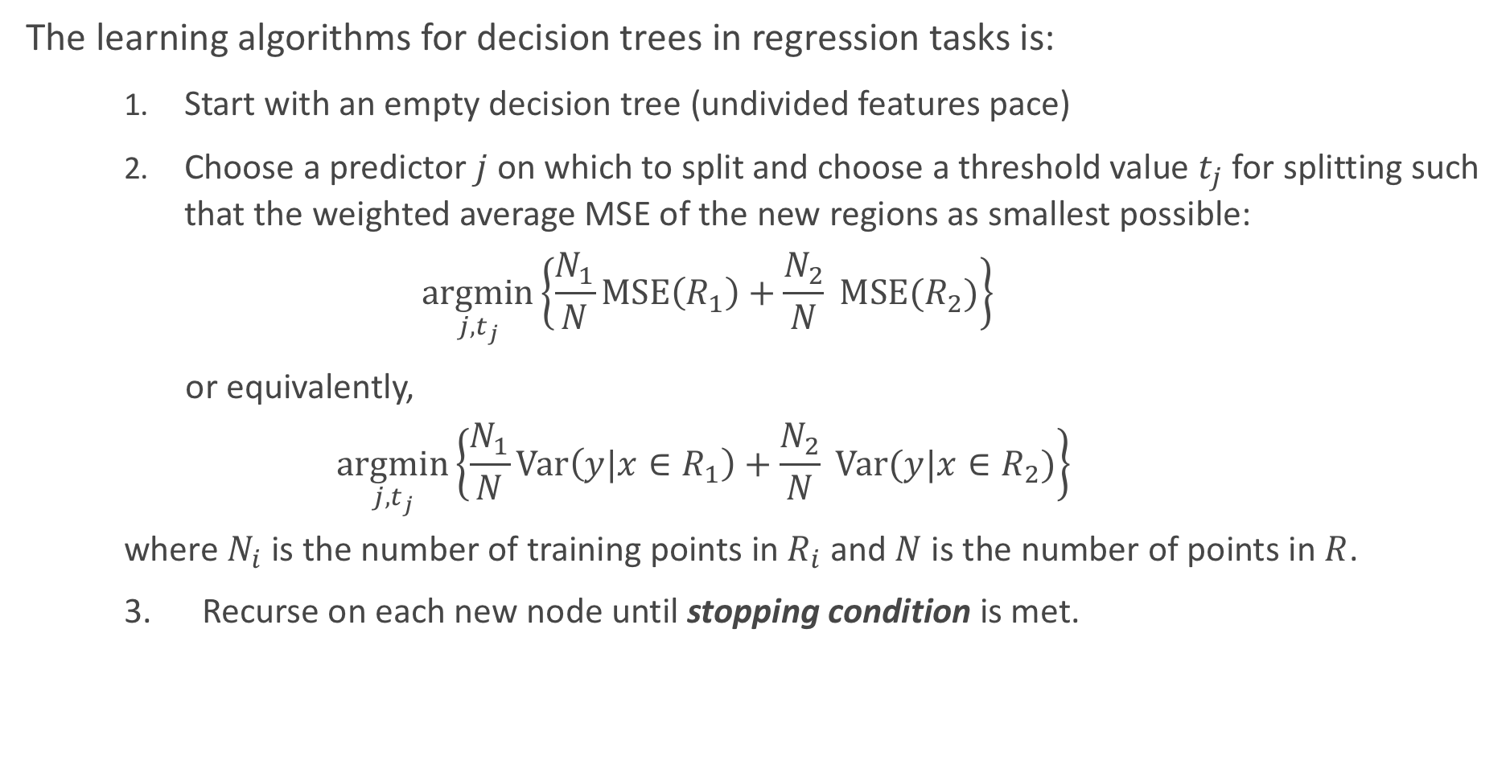
Learning Regression Trees
The learning algorithms for decision trees in regression tasks is:
Start with an empty decision tree (undivided features pace)
Choose a predictor $j$ on which to split and choose a threshold value $t_{j}$ for splitting such that the weighted average MSE of the new regions as smallest possible:
$$\underset{j, t_{j}}{argmin}\left\{\frac{N_{1}}{N}MSE\left(R_{1}\right)+\frac{N_{2}}{N} MSE(R_{2})\right\}$$
or equivalently,
$$\underset{j, t_{j}}{argmin}\left\{\frac{N_{1}}{N}Var\left(y|x∈R_{1}\right)+\frac{N_{2}}{N} Var(y|x∈R_{2})\right\}$$ where $N_{i}$ is the number of training points in $R_{i}$ and $N$ is the number of points in $R$.
3. Recurse on each new node until stopping condition is met.

Slide 61
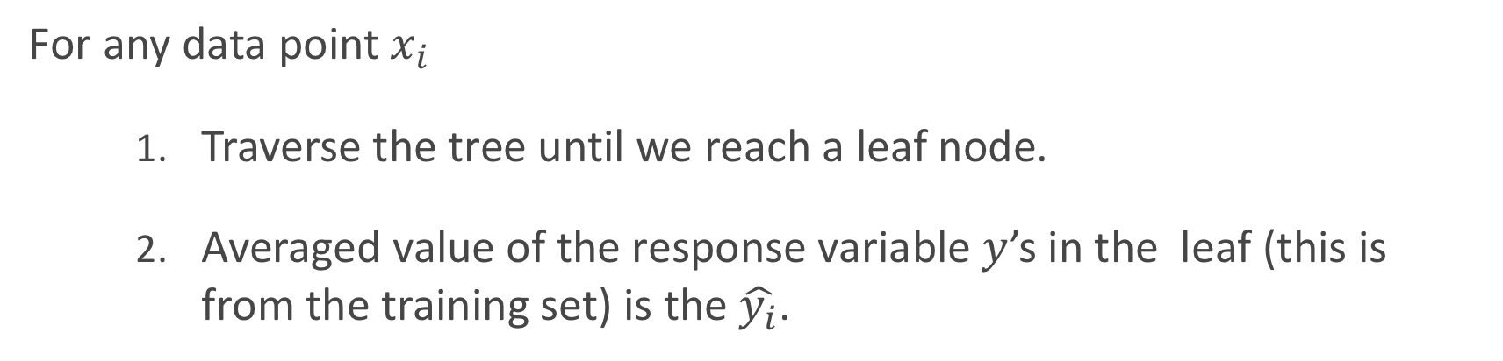
Regression Trees Prediction
For any data point $x_{i}$
Traverse the tree until we reach a leaf node.
Averaged value of the response variable $y$’s in the leaf (this is from the training set) is the $\hat{y_{i}}$.

Slide 62
Regression Tree Example
How do we decide a split here? Where should we split?

Slide 63
Regression Tree (max_depth = 1)
If we go to a depth of 2, where should we split next?

Slide 64
Regression Tree (max_depth = 2)

Slide 65
Regression Tree (max_depth = 5)

Slide 66
Regression Tree (max_depth = 10)

Slide 67
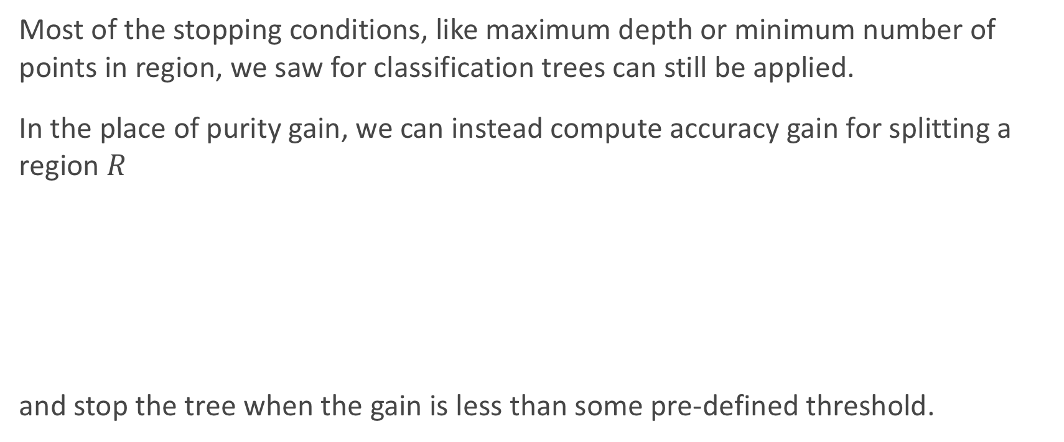
Stopping Conditions
Most of the stopping conditions, like maximum depth or minimum number of points in region, we saw for classification trees can still be applied.
In the place of purity gain, we can instead compute accuracy gain for splitting a region $R$
and stop the tree when the gain is less than some pre-defined threshold.

Slide 68
Overfitting
Same issues as with classification trees. Avoid overfitting by pruning or limiting the depth of the tree and using CV.

Slide 69
Bootstrap-Aggregating (Bagging)

Slide 70
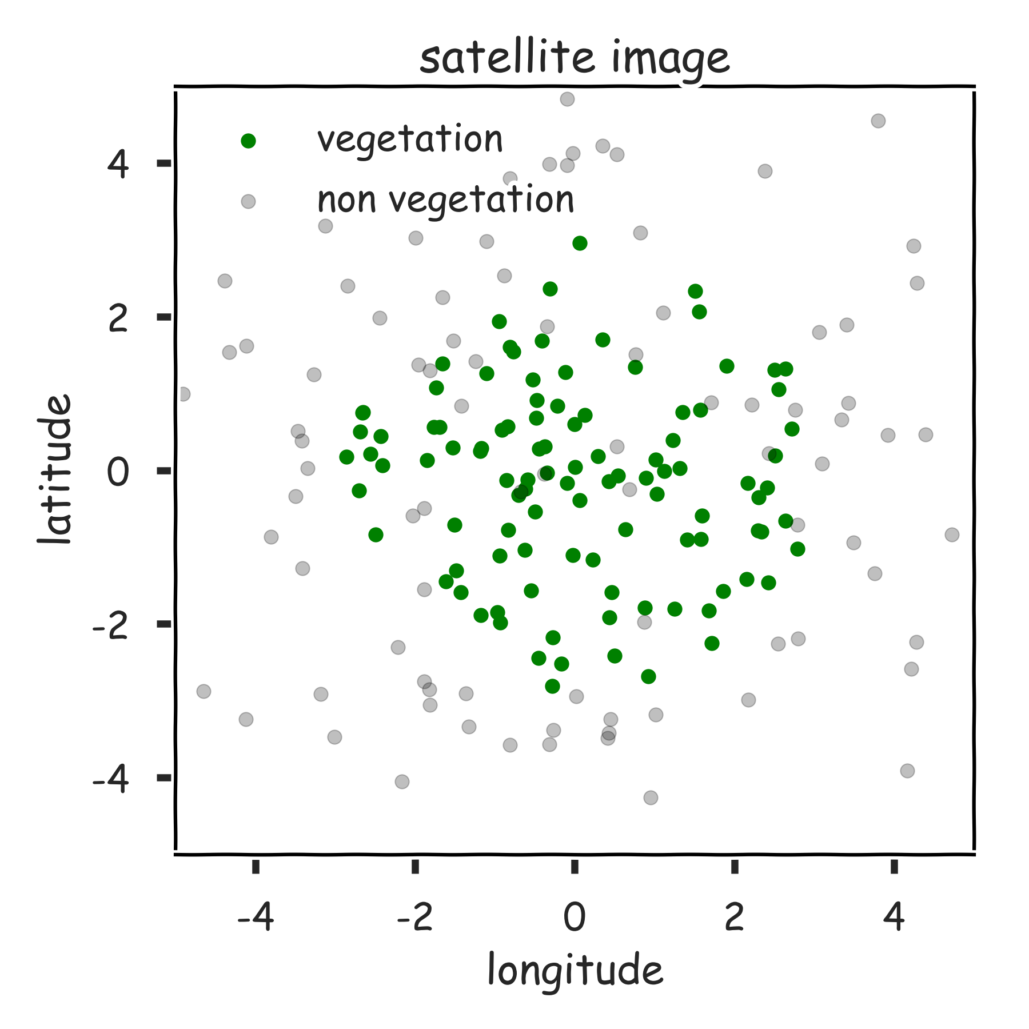
Reduce the variance

Slide 71
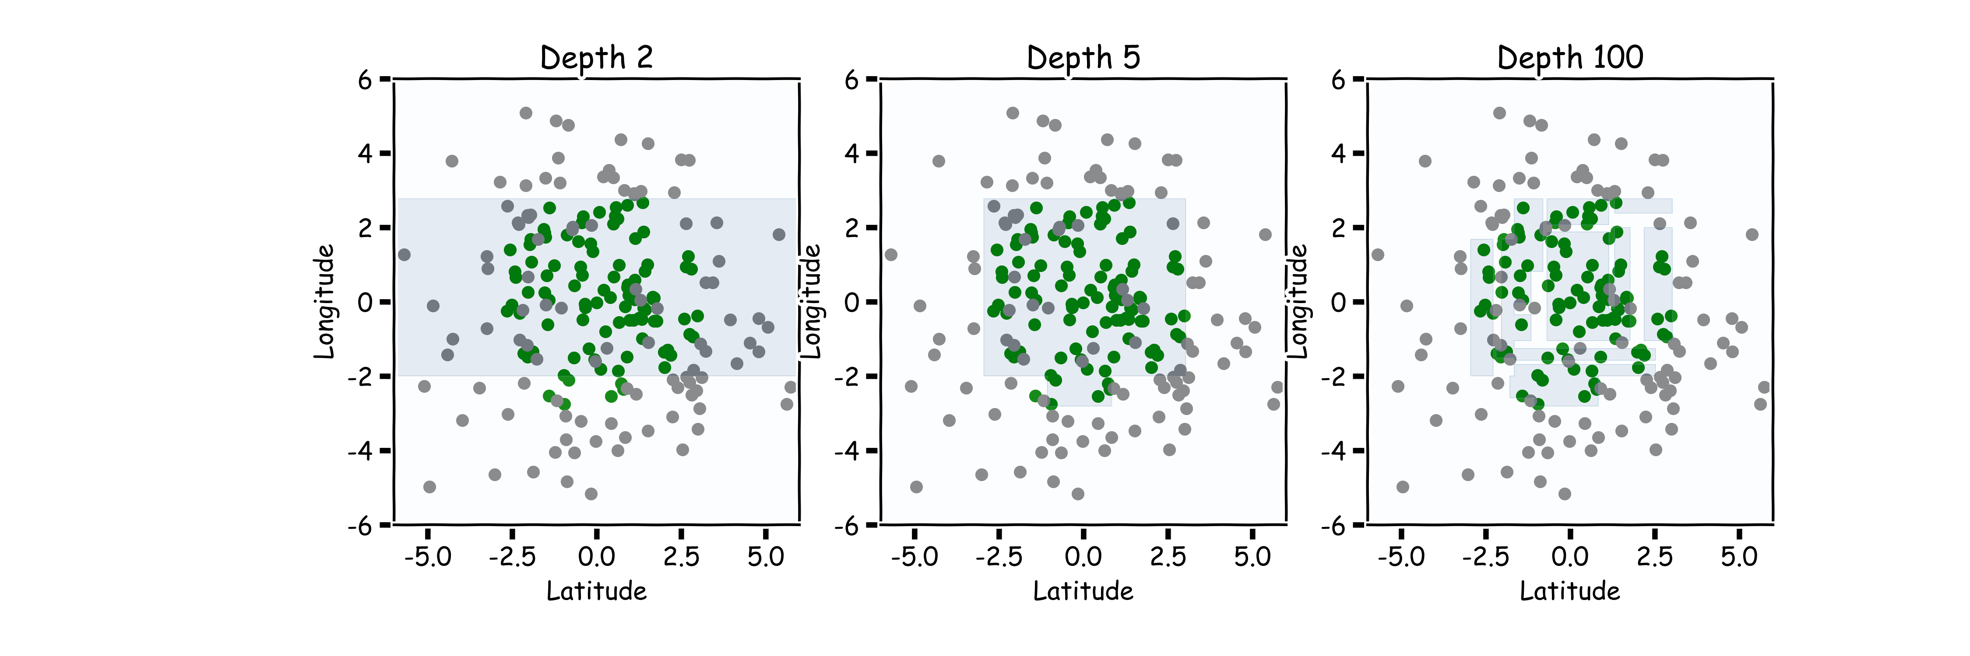
Hyper-parameters: Depth

Slide 72
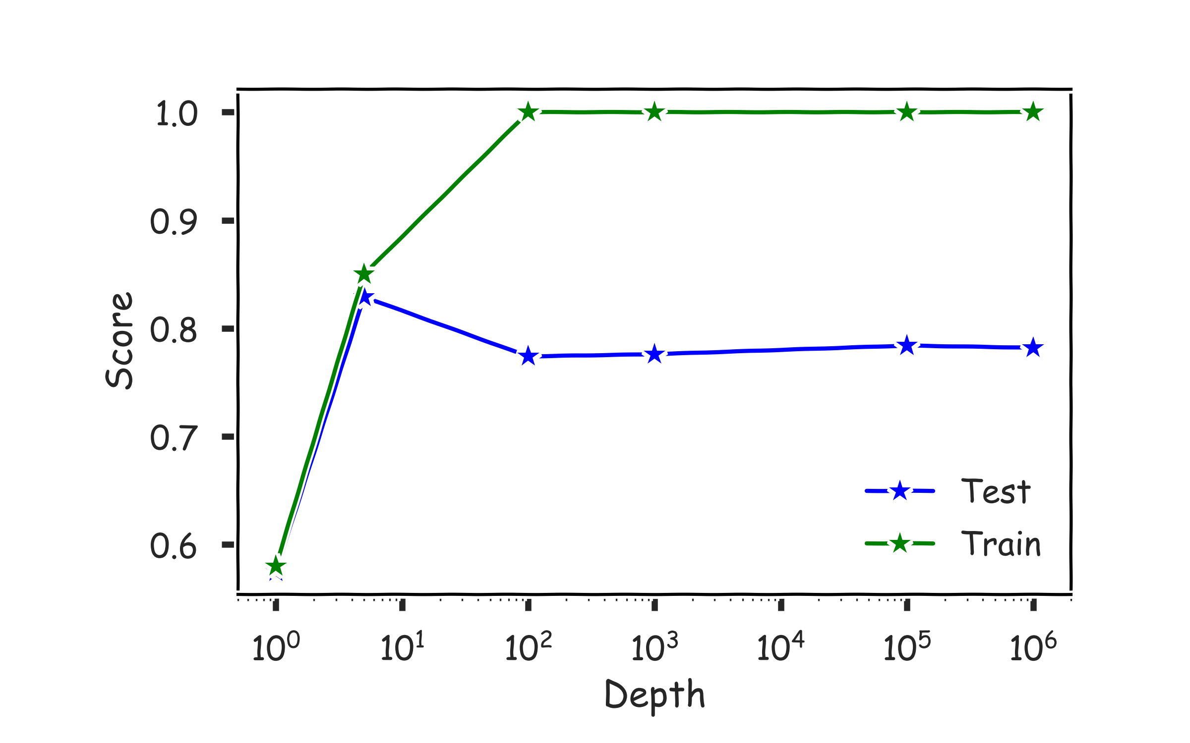
Hyper-parameters: Depth
Use train/validation or cross validation to estimate the best depth.
Val

Slide 73
Magic realism: Bootstrap

Slide 74
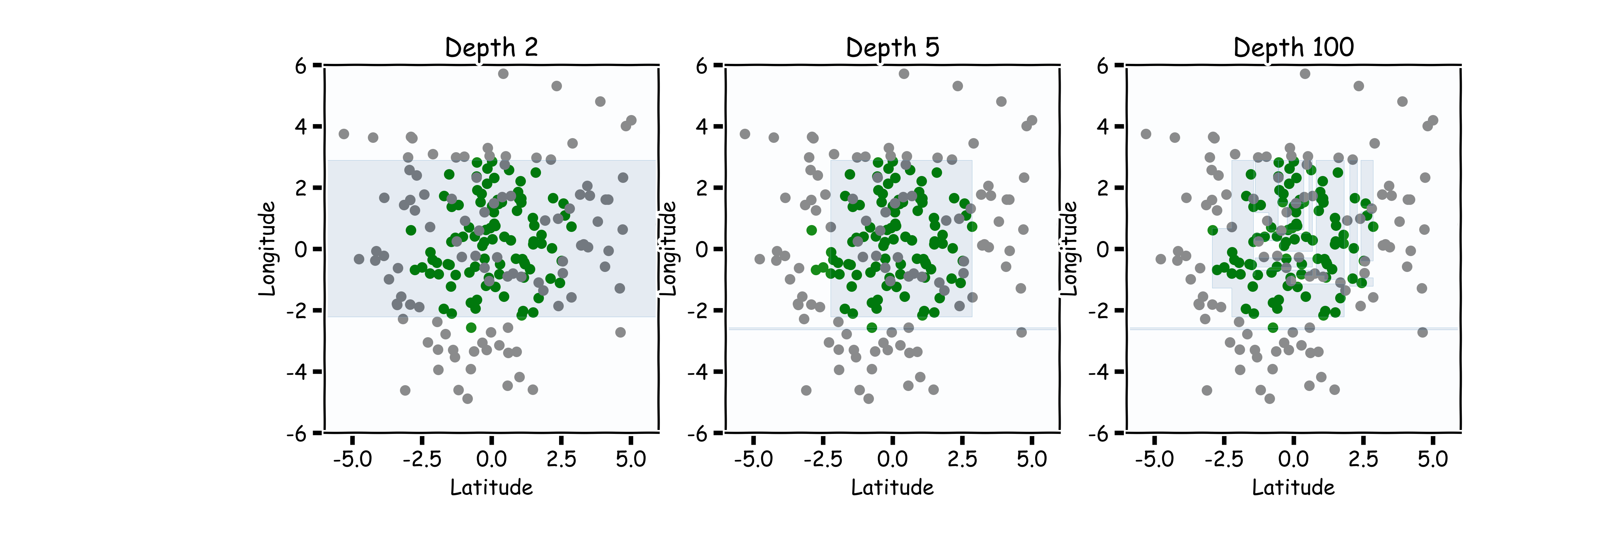
Magic realism: Bootstrap

Slide 75
Limitations of Decision Tree Models
Decision trees models are highly interpretable and fast to train, using our greedy learning algorithm.
However, in order to capture a complex decision boundary (or to approximate a complex function), we need to use a large tree (since each time we can only make axis aligned splits).
We’ve seen that large trees have high variance and are prone to overfitting.
For these reasons, in practice, decision tree models often underperforms when compared with other classification or regression methods.

Slide 76
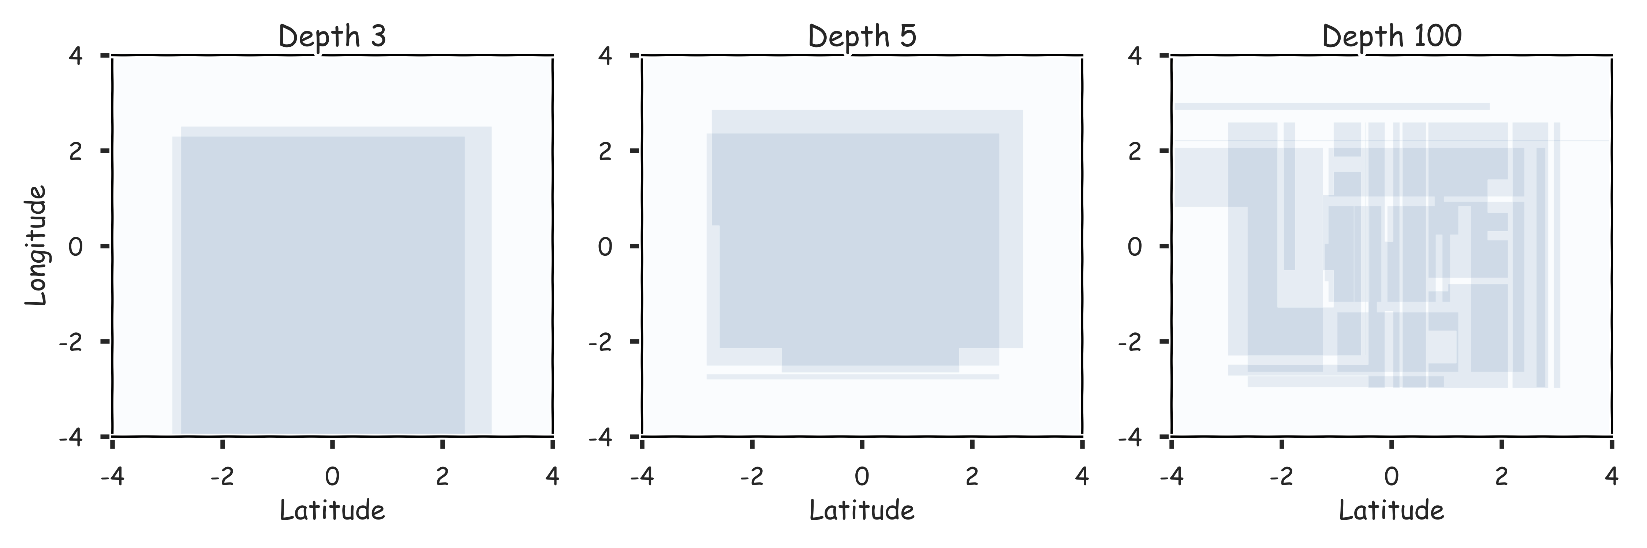
Combine them? 2 magic realisms

Slide 77
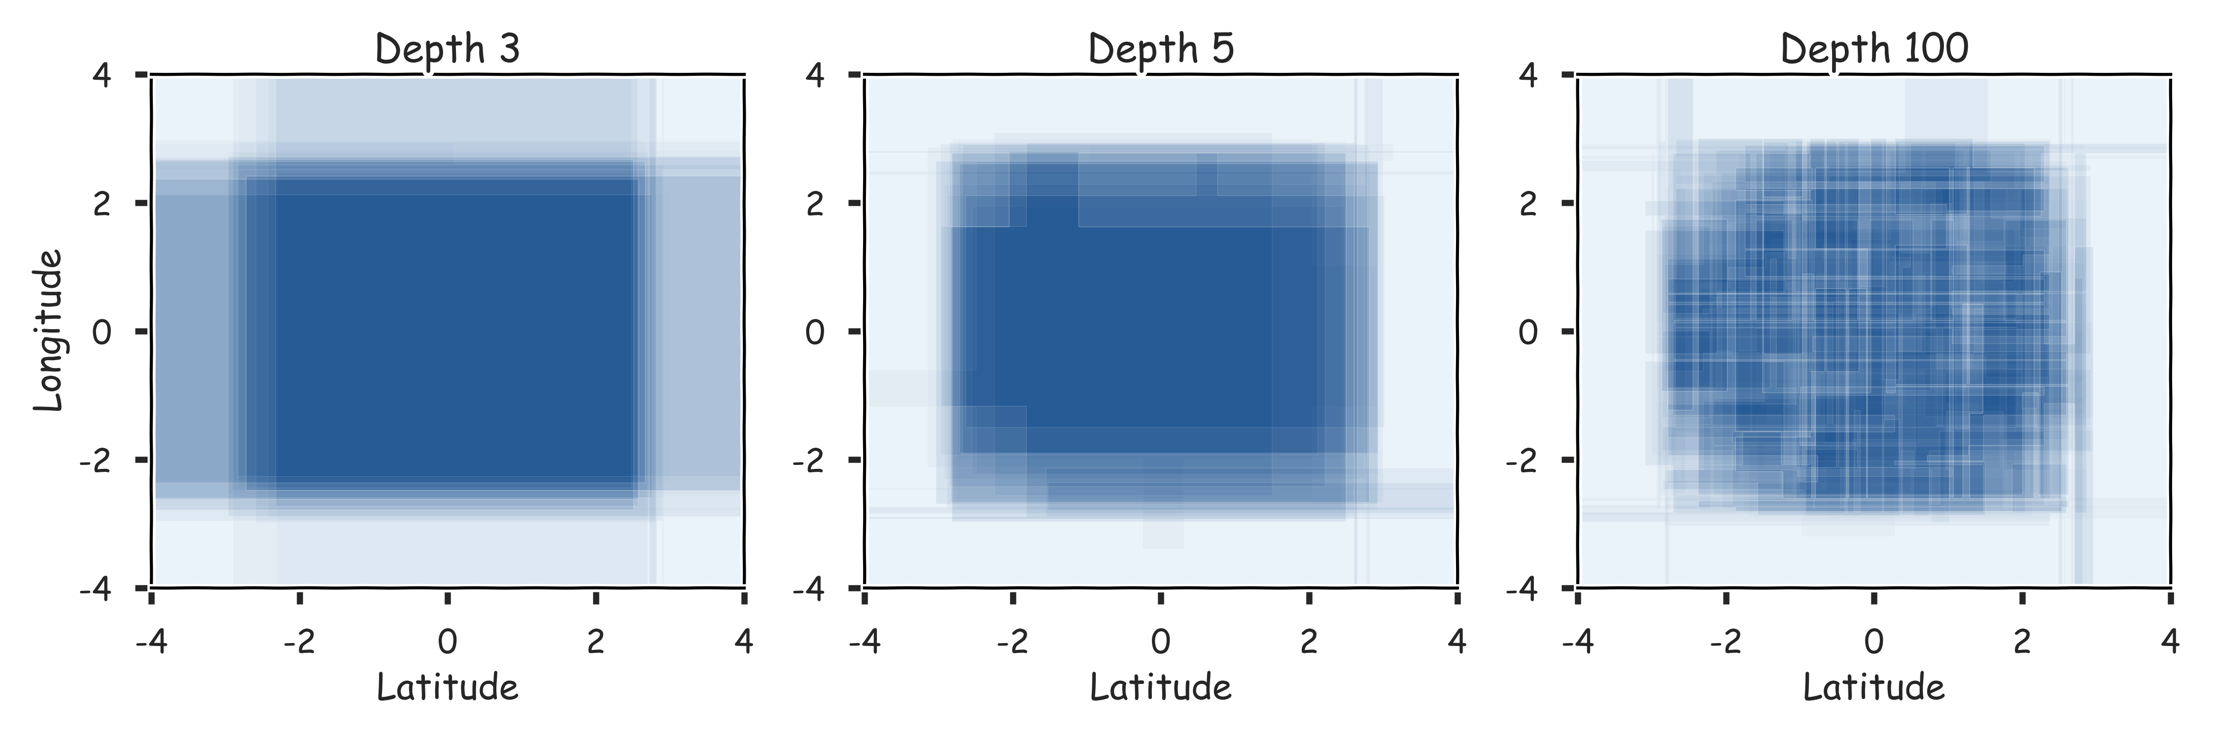
Combine them? 20 magic realisms

Slide 78
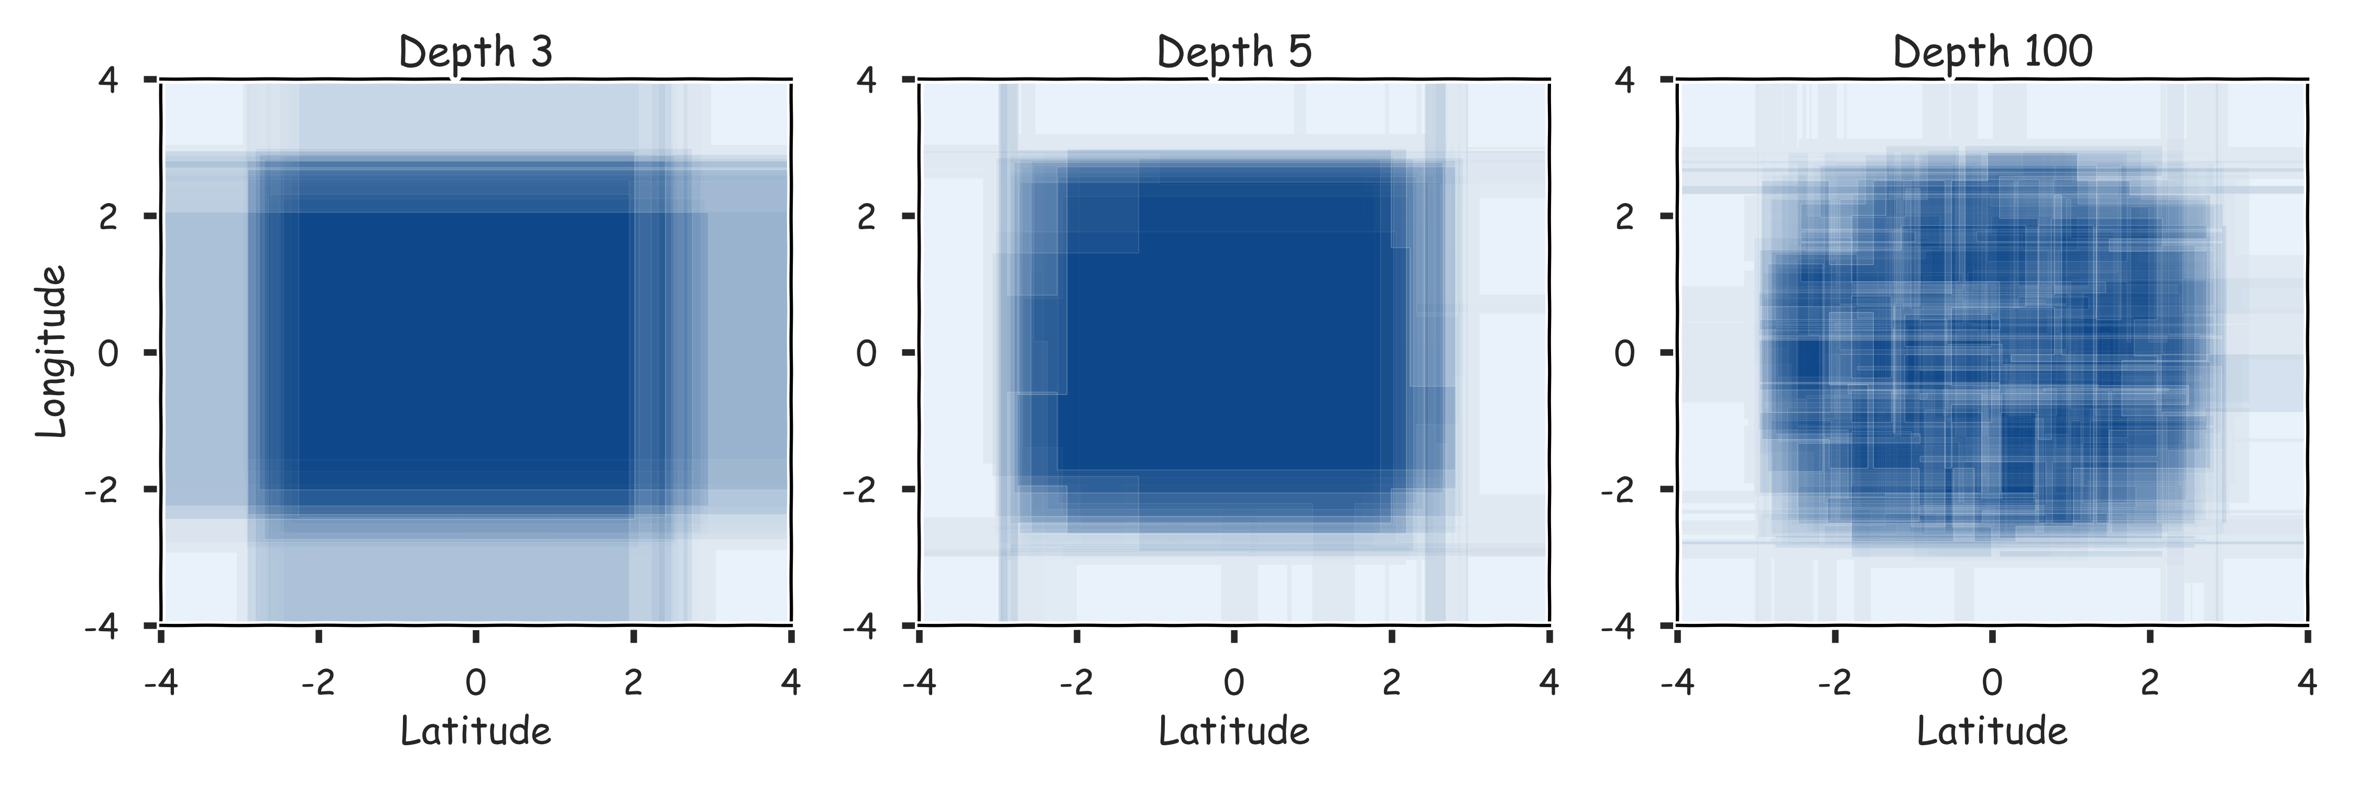
Combine them? 100 magic realisms

Slide 79
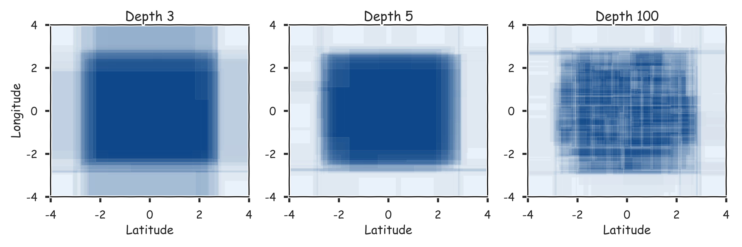
Combine them? 300 magic realisms

Slide 80
Bagging
One way to adjust for the high variance of the output of an experiment is to perform the experiment multiple times and then average the results.
The same idea can be applied to high variance models:
(Bootstrap)we generate multiple samples of training data, via bootstrapping. We train a full decision tree on each sample of data.
(Aggregate)for a given input, we output the averaged outputs of all the models for that input.
For classification, we return the class that is outputted by the plurality of the models. For regression we return the average of the outputs for each tree.
This method is called Bagging (Breiman, 1996), short for, of course, Bootstrap Aggregating.

Slide 81
Bagging
Note that bagging enjoys the benefits of:
High expressiveness - by using full trees each model is able to approximate complex functions and decision boundaries.
Low variance - averaging the prediction of all the models reduces the variance in the final prediction, assuming that we choose a sufficiently large number of trees.

Slide 82
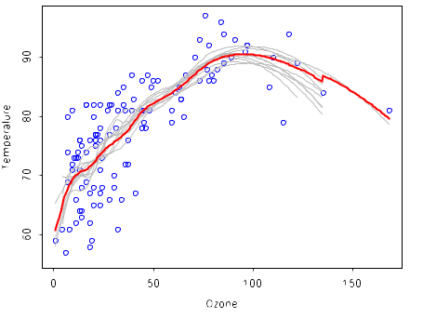
Bagging (regression)

Slide 83
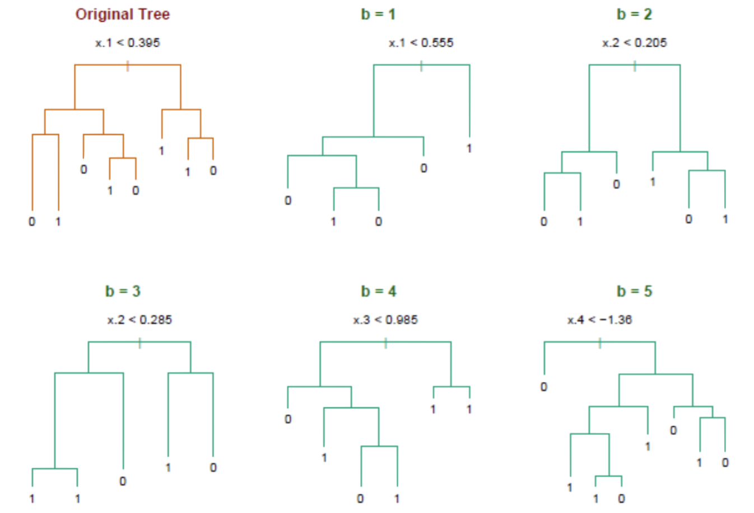
Bagging (classification)

Slide 84
Bagging
Question: Do you see any problems?
Still some overfitting if the trees are too large.
If trees are too shallow it can still underfits.
Interpretability:
The major drawback of bagging (and other ensemble methods that we will study) is that the averaged model is no longer easily interpretable - i.e. one can no longer trace the ‘logic’ of an output through a series of decisions based on predictor values!

Slide 85
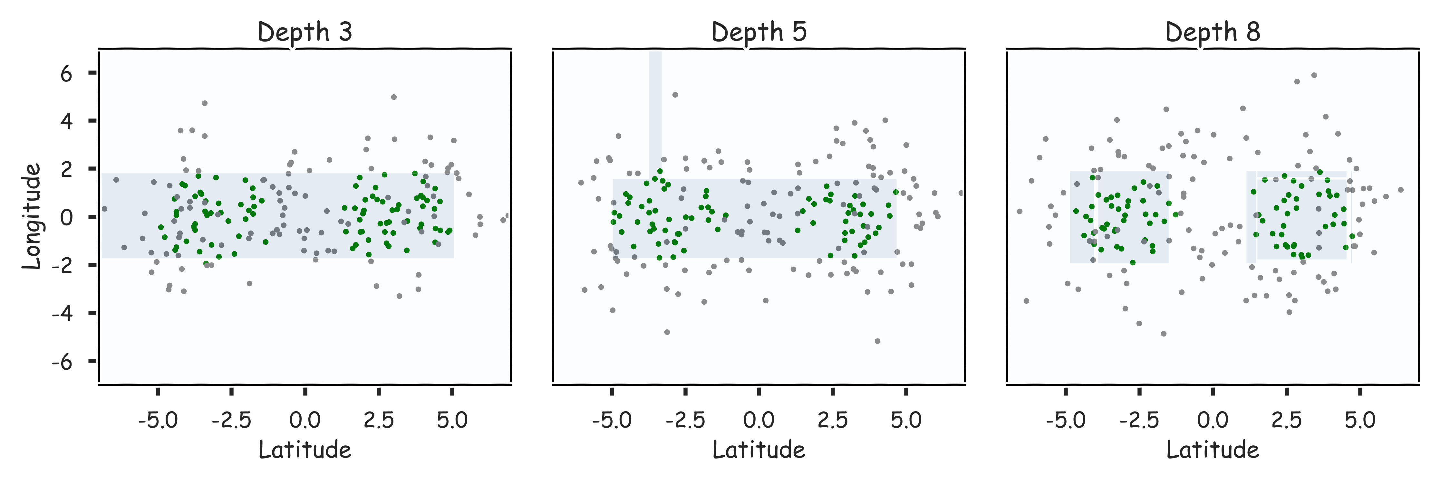
Case of underfitting

Slide 86
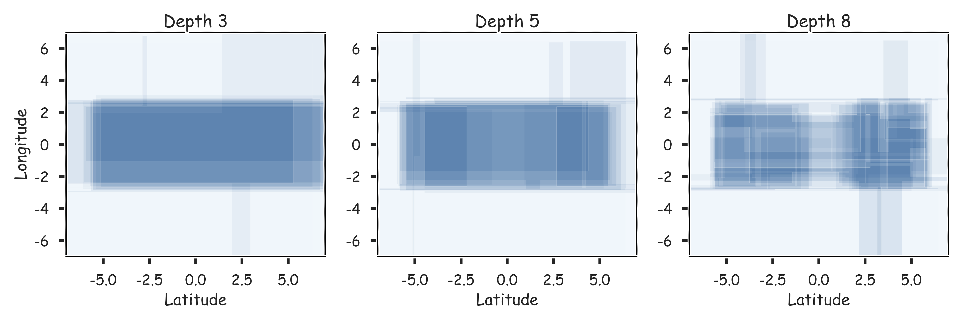
Case of underfitting

Slide 87
Bagging
Question: Do you see any problems?
Still some overfitting if the trees are too large
If trees are too shallow it can still underfits.
Cross Validations

Slide 88
Out-of-Bag Error

Slide 89
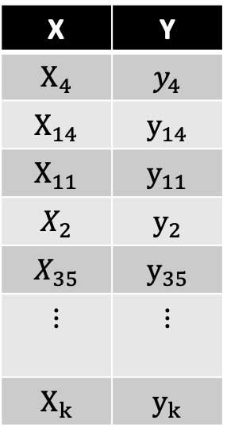
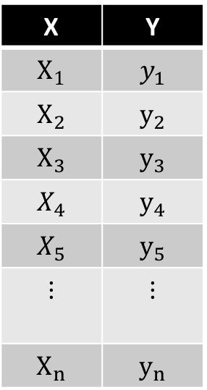
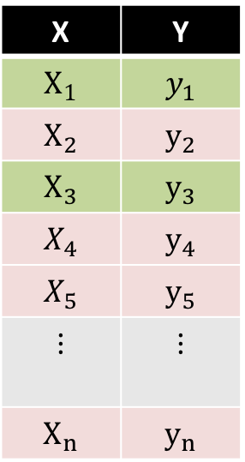
Bagging
Original Data
Bootstrap Sample 1
Decision Tree 1
Used and unused data
X | Y
$$X_{1}$$ | $$y_{1}$$
$$X_{2}$$ | $$y_{2}$$
$$X_{3}$$ | $$y_{3}$$
$$X_{4}$$ | $$y_{4}$$
$$X_{5}$$ | $$y_{5}$$
$$⋮$$ | $$⋮$$
$$X_{n}$$ | $$y_{n}$$
X | Y
$$X_{4}$$ | $$y_{4}$$
$$X_{14}$$ | $$y_{14}$$
$$X_{11}$$ | $$y_{11}$$
$$X_{2}$$ | $$y_{2}$$
$$X_{35}$$ | $$y_{35}$$
$$⋮$$ | $$⋮$$
$$X_{k}$$ | $$y_{k}$$
X | Y
$$X_{1}$$ | $$y_{1}$$
$$X_{2}$$ | $$y_{2}$$
$$X_{3}$$ | $$y_{3}$$
$$X_{4}$$ | $$y_{4}$$
$$X_{5}$$ | $$y_{5}$$
$$⋮$$ | $$⋮$$
$$X_{n}$$ | $$y_{n}$$

Slide 90


Bagging
Original Data
Bootstrap Sample 2
Decision Tree 2
Used and unused data
X | Y
$$X_{1}$$ | $$y_{1}$$
$$X_{2}$$ | $$y_{2}$$
$$X_{3}$$ | $$y_{3}$$
$$X_{4}$$ | $$y_{4}$$
$$X_{5}$$ | $$y_{5}$$
$$⋮$$ | $$⋮$$
$$X_{n}$$ | $$y_{n}$$
X | Y
$$X_{5}$$ | $$y_{5}$$
$$X_{3}$$ | $$y_{3}$$
$$X_{12}$$ | $$y_{12}$$
$$X_{43}$$ | $$y_{43}$$
$$X_{1}$$ | $$y_{1}$$
$$⋮$$ | $$⋮$$
$$X_{k}$$ | $$y_{k}$$
X | Y
$$X_{1}$$ | $$y_{1}$$
$$X_{2}$$ | $$y_{2}$$
$$X_{3}$$ | $$y_{3}$$
$$X_{4}$$ | $$y_{4}$$
$$X_{5}$$ | $$y_{5}$$
$$⋮$$ | $$⋮$$
$$X_{n}$$ | $$y_{n}$$

Slide 91


Bagging
Original Data
Bootstrap Sample 3
Decision Tree 3
Used and unused data
X | Y
$$X_{1}$$ | $$y_{1}$$
$$X_{2}$$ | $$y_{2}$$
$$X_{3}$$ | $$y_{3}$$
$$X_{4}$$ | $$y_{4}$$
$$X_{5}$$ | $$y_{5}$$
$$⋮$$ | $$⋮$$
$$X_{n}$$ | $$y_{n}$$
X | Y
$$X_{9}$$ | $$y_{9}$$
$$X_{4}$$ | $$y_{4}$$
$$X_{1}$$ | $$y_{1}$$
$$X_{1}$$ | $$y_{1}$$
$$X_{65}$$ | $$y_{65}$$
$$⋮$$ | $$⋮$$
$$X_{k}$$ | $$y_{k}$$
X | Y
$$X_{1}$$ | $$y_{1}$$
$$X_{2}$$ | $$y_{2}$$
$$X_{3}$$ | $$y_{3}$$
$$X_{4}$$ | $$y_{4}$$
$$X_{5}$$ | $$y_{5}$$
$$⋮$$ | $$⋮$$
$$X_{n}$$ | $$y_{n}$$

Slide 92

Point-wise out-of-bag error
X | Y
$$X_{1}$$ | $$y_{1}$$
$$X_{2}$$ | $$y_{2}$$
$$X_{3}$$ | $$y_{3}$$
$$⋮$$ | $$⋮$$
$$X_{i}$$ | $$y_{i}$$
$$⋮$$ | $$⋮$$
$$X_{n}$$ | $$y_{n}$$

Slide 93






Point-wise out-of-bag error
B Trees that did not see $\{X_{i},y_{i}\}$
X | Y
$$X_{1}$$ | $$y_{1}$$
$$X_{2}$$ | $$y_{2}$$
$$X_{3}$$ | $$y_{3}$$
$$⋮$$ | $$⋮$$
$$X_{i}$$ | $$y_{i}$$
$$⋮$$ | $$⋮$$
$$X_{n}$$ | $$y_{n}$$
Classification
$${\hat{y}}_{i,pw}=majority({{\hat{y}}_{i})}$$
$$e_{i}= 𝕀({\hat{y}}_{i,pw}≠y_{i})$$
Regression
$${\hat{y}}_{i,pw}=\sum_{j∈B}{{\hat{y}}_{i,j}}$$
$$e_{i}={\left(y_{i}−{\hat{y}}_{i.pw}\right)}^{2}$$

Slide 94


OOB Error
We average the point-wise out-of-bag error over the full training set.
Classification
$$Error_{OOB}=\sum_{i}^{n}{e_{i}}=\sum_{i}^{n}{𝕀({\hat{y}}_{i,pw}≠y_{i}) }$$
Regression
$$Error_{OOB}=\sum_{i}^{n}{e_{i}}=\sum_{i}^{n}{{\left(y_{i}−{\hat{y}}_{i,pw}\right)}^{2}}$$

Slide 95
Out-of-Bag Error
Bagging is an example of an ensemble method, a method of building a single model by training and aggregating multiple models.
With ensemble methods, we get a new metric for assessing the predictive performance of the model, the out-of-bag error.
Given a training set and an ensemble of models, each trained on a bootstrap sample, we compute the out-of-bag error of the averaged model by
For each point in the training set, we average the predicted output for this point over the models whose bootstrap training set excludes this point. We compute the error or squared error of this averaged prediction. Call this the point-wise out-of-bag error.
We average the point-wise out-of-bag error over the full training set.

Slide 96
Bagging
Question: Do you see any problems?
Still some overfitting if the trees are too large.
If trees are too shallow it can still underfits.
Interpretability:
The major drawback of bagging (and other ensemble methods that we will study) is that the averaged model is no longer easily interpretable - i.e. one can no longer trace the ‘logic’ of an output through a series of decisions based on predictor values!

Slide 97


Variable Importance for Bagging
Bagging improves prediction accuracy at the expense of interpretability.
Calculate the total amount that the MSE (for regression) or Gini index (for classification) is decreased due to splits over a given predictor, averaged over all $B$ trees.
100 trees, max_depth=10

Slide 98

Improving on Bagging
In practice, the ensembles of trees in Bagging tend to be highly correlated.
Suppose we have an extremely strong predictor, $x_{j}$ , in the training set amongst moderate predictors. Then the greedy learning algorithm ensures that most of the models in the ensemble will choose to split on $x_{j}$ in early iterations.
That is, each tree in the ensemble is identically distributed, with the expected output of the averaged model the same as the expected output of any one of the trees.

Slide 99


Improving on Bagging
Recall, for $B$ number of identically and independently distributed variable, X, with variance $σ^{2}$, the variance of the estimate of the mean is :
$$var\left({\hat{μ}}_{x}\right)=\frac{σ^{2}}{B}$$

Slide 100


Improving on Bagging
For $B$ number of identically but not independently distributed variables with pairwise correlation $ρ$ and variance $σ^{2}$, the variance of their mean is
$$var\left({\hat{μ}}_{x}\right)∝σ^{2}(1+ρ^{2})/B$$

Slide 101
Bagging
Question: Do you see any problems?
Still some overfitting if the trees are too large
If trees are too shallow it can still underfits.
interpretability
The major drawback of bagging (and other ensemble methods that we will study) is that the averaged model is no longer easily interpretable - i.e. one can no longer trace the ‘logic’ of an output through a series of decisions based on predictor values!

Slide 102

Zeenat Potia

Slide 103
Random Forests

Slide 104

Random Forests
Random Forest is a modified form of bagging that creates ensembles of independent decision trees.
To de-correlate the trees, we:
train each tree on a separate bootstrap sample of the full training set (same as in bagging)
for each tree, at each split, we randomly select a set of $J′$ predictors from the full set of predictors.
From amongst the $J′$ predictors, we select the optimal predictor and the optimal corresponding threshold for the split.

Slide 105
Tuning Random Forests
Random forest models have multiple hyper-parameters to tune:
the number of predictors to randomly select at each split
the total number of trees in the ensemble
the minimum leaf node size
In theory, each tree in the random forest is full, but in practice this can be computationally expensive (and added redundancies in the model), thus, imposing a minimum node size is not unusual.

Slide 106

Tuning Random Forests
There are standard (default) values for each of random forest hyper-parameters recommended by long time practitioners, but generally these parameters should be tuned through OOB (making them data and problem dependent).
e.g. number of predictors to randomly select at each split:
$√N_{j}$ for classification
$\frac{N}{3}$ for regression
Using out-of-bag errors, training and cross validation can be done in a single sequence - we cease training once the out-of-bag error stabilizes

Slide 107

Variable Importance for RF
Same as with Bagging:
Calculate the total amount that the RSS (for regression) or Gini index (for classification) is decreased due to splits over a given predictor, averaged over all $B$ trees.

Slide 108

Variable Importance for RF
Alternative:
Record the prediction accuracy on the oob samples for each tree.
Randomly permute the data for column $j$in the oob samples the record the accuracy again.
The decrease in accuracy as a result of this permuting is averaged over all trees, and is used as a measure of the importance of variable $j$ in the random forest.

Slide 109

Variable Importance for RF
100 trees, max_depth=10

Slide 110

Variable Importance for RF
100 trees, max_depth=10

Slide 111
Final Thoughts on Random Forests
When the number of predictors is large, but the number of relevant predictors is small, random forests can perform poorly.
Question: Why?
In each split, the chances of selected a relevant predictor will be low and hence most trees in the ensemble will be weak models.

Slide 112
Final Thoughts on Random Forests (cont.)
Increasing the number of trees in the ensemble generally does not increase the risk of overfitting.
Again, by decomposing the generalization error in terms of bias and variance, we see that increasing the number of trees produces a model that is at least as robust as a single tree.
However, if the number of trees is too large, then the trees in the ensemble may become more correlated, increase the variance.

Slide 113
Final Thoughts on Random Forests (cont.)
Probabilities:
Random Forrest Classifier (and bagging, and not fully complex trees) can return probabilities.
Question: How?

